Slide 1
EQUINE MATURE ENDOMETRIAL CUP
Endometrial cups from day 68 and day 83 of gestation have been chosen to illustrate the mature cup.
Allen C. Enders
University of California Davis

Slide 2
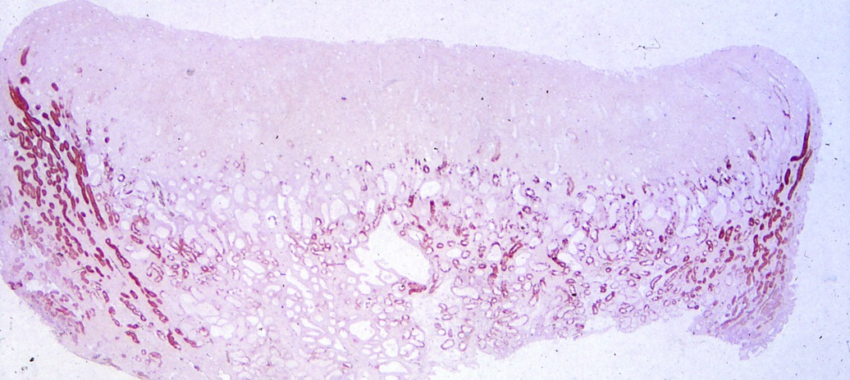
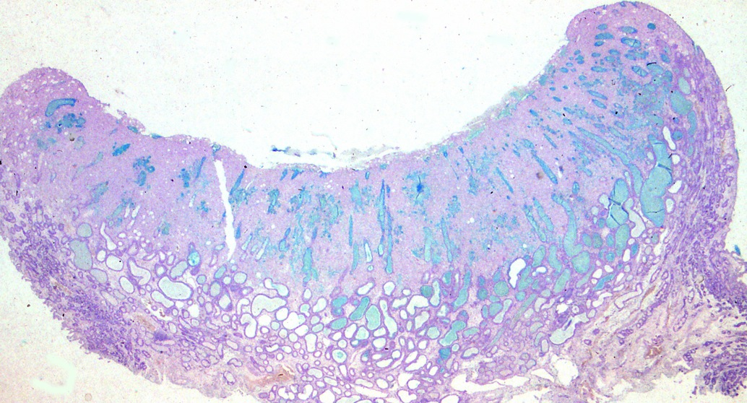
Endometrial cup day 68 immunostained for TGFa, showing reaction in peripheral glands and basal glands, but not in the main portion of the cup.
Cup stained with alcian blue, showing intensely stained gland product within the cup and in some dilated glands below the cup. Note absence of alcian blue gland product in peripheral glands.

Slide 3
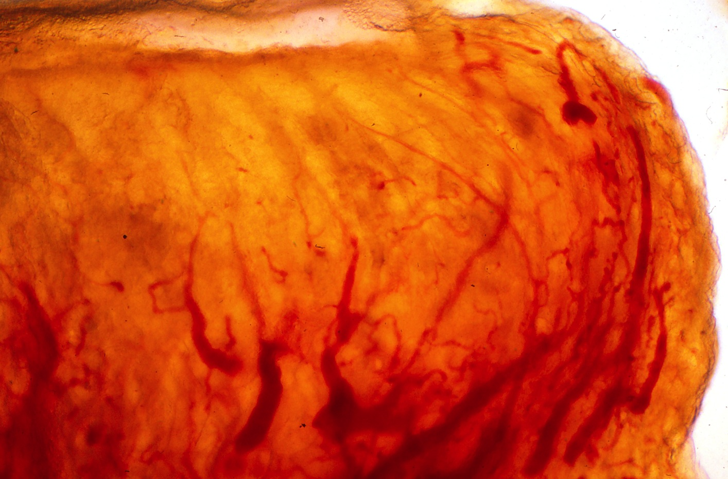
Thick section showing endometrial vessels; note that they are more abundant at the margin of the cup, and least abundant in the main portion of the cup.

Slide 4
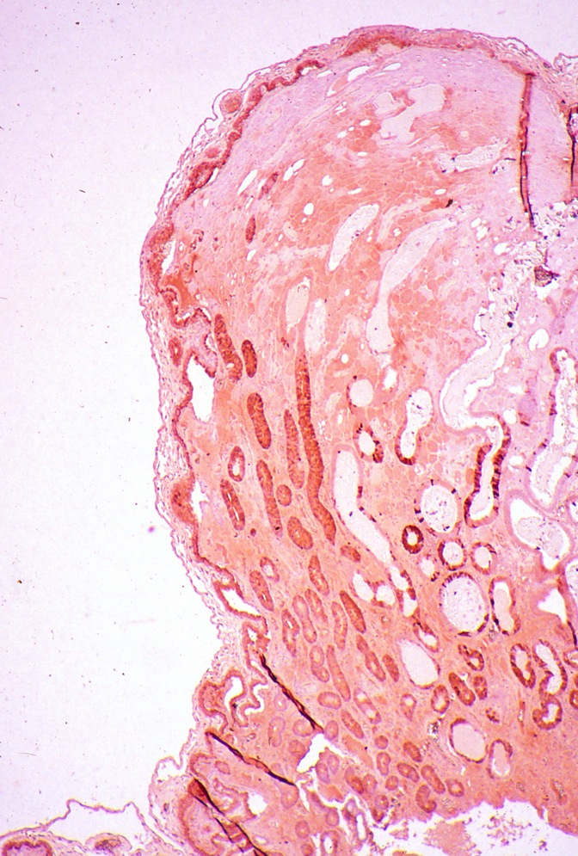
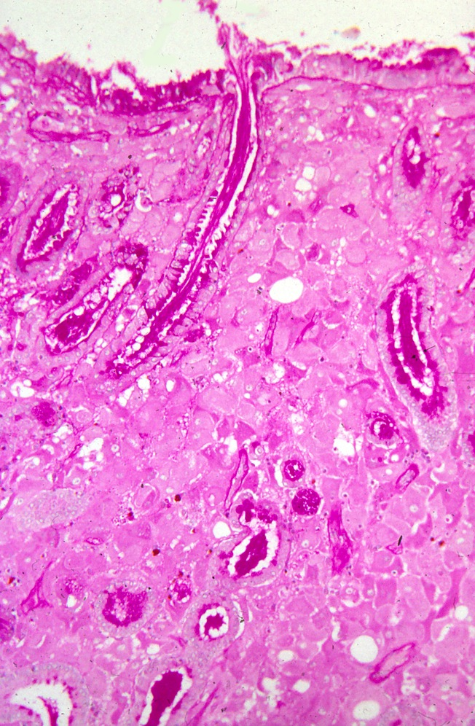
TGFa staining of glands peripheral to the cup, and intense staining in some glands below the cup.
PAS stain; the gland secretions are intensely stained as are apices of gland cells.

Slide 5
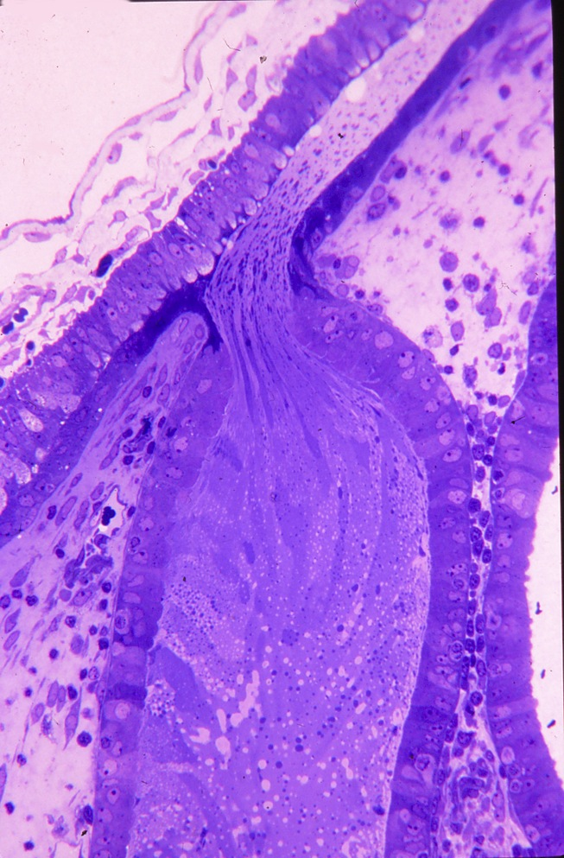
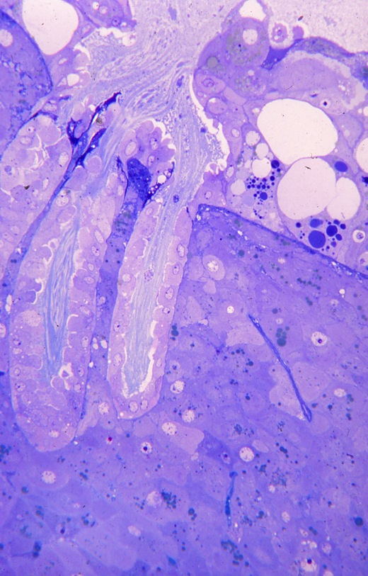
Openings of three glands on the left onto surface of the cup. The majority of cup cells appear healthy but some cells near the gland opening are vacuolated and distorted.
A gland opens under the trophoblast of the allantochorion.

Slide 6
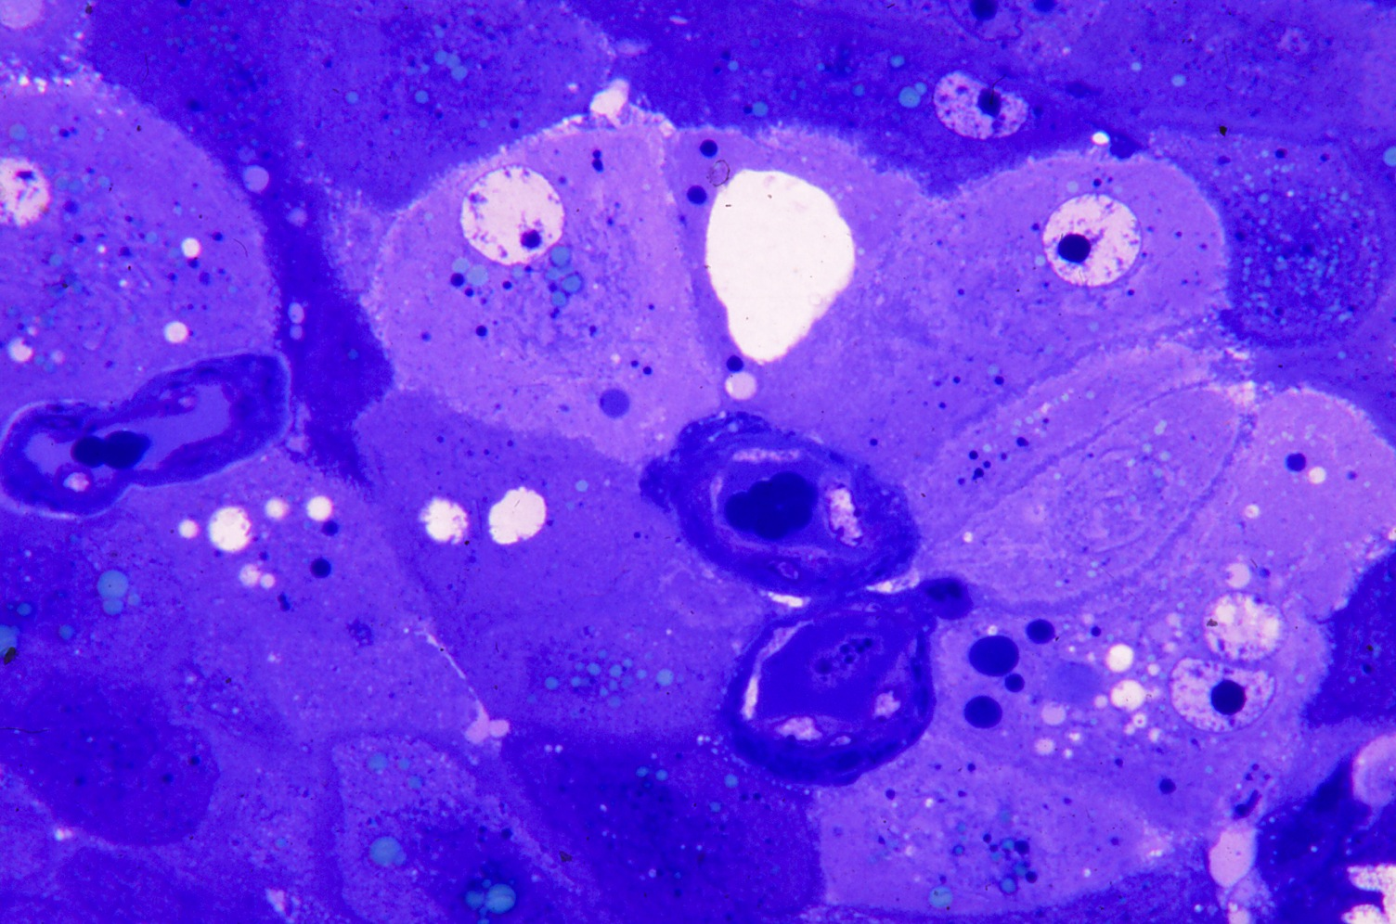
Cup cells around three endometrial vessels; note thick basal laminas.

Slide 7
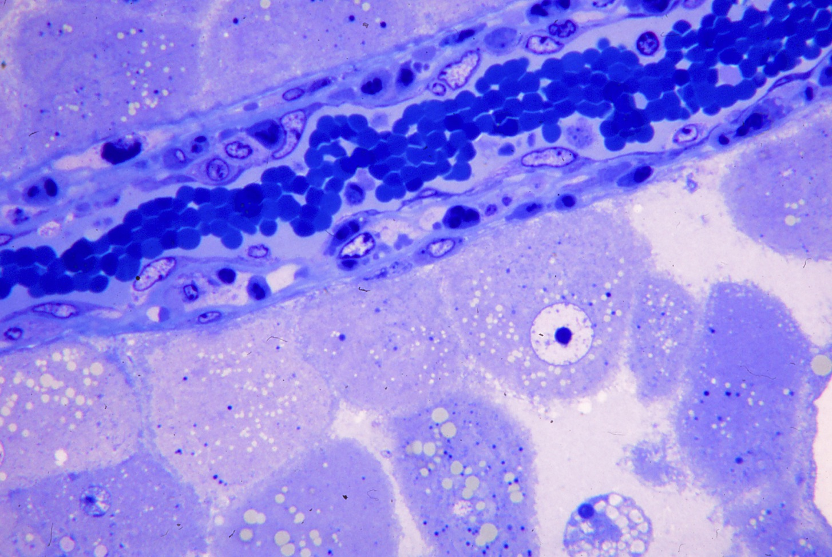
Across the top is an endometrial vessel showing infiltration by lymphocytes.
Cup cells are healthy with some lipid and vacuolation.

Slide 8
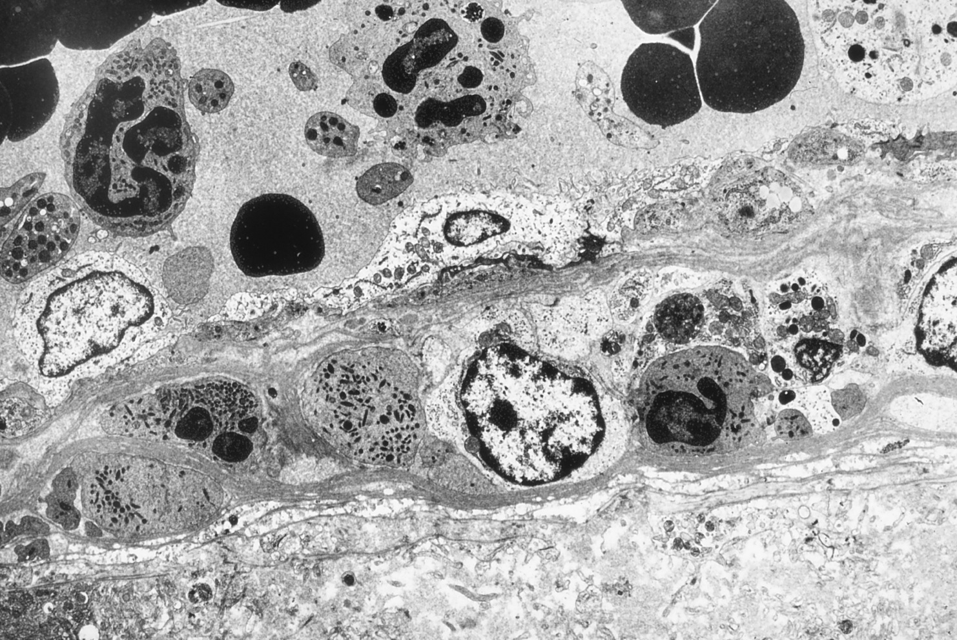
TEM of a similar endometrial vessel. Note numerous polys in the lumen, and a lymphocyte as well as polys in the wall of the vessel.

Slide 9
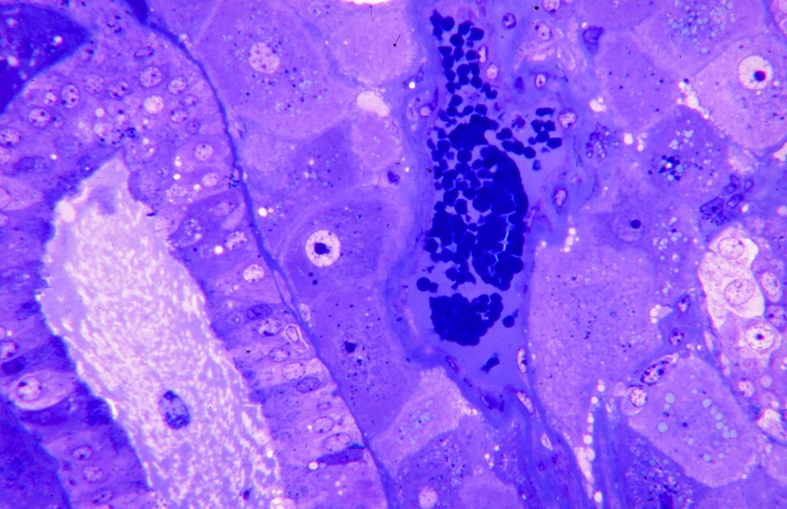
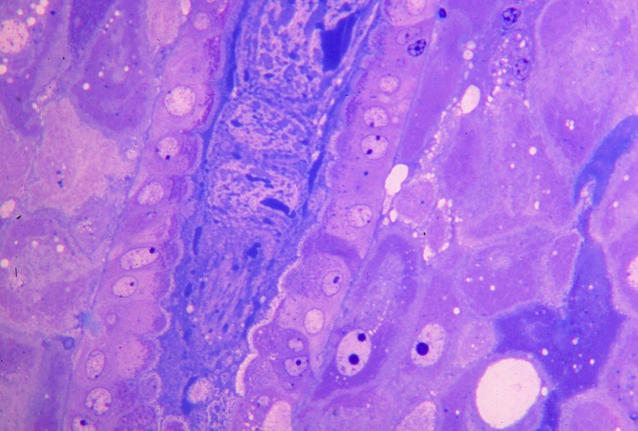
A normal gland on the left and an endometrial vessel with only slightly thickened basal lamina in the center.
Heterogeneous secretion collects in the gland lumen. Note pale Golgi region in cup cells in the lower center beneath the gland epithelium.

Slide 10
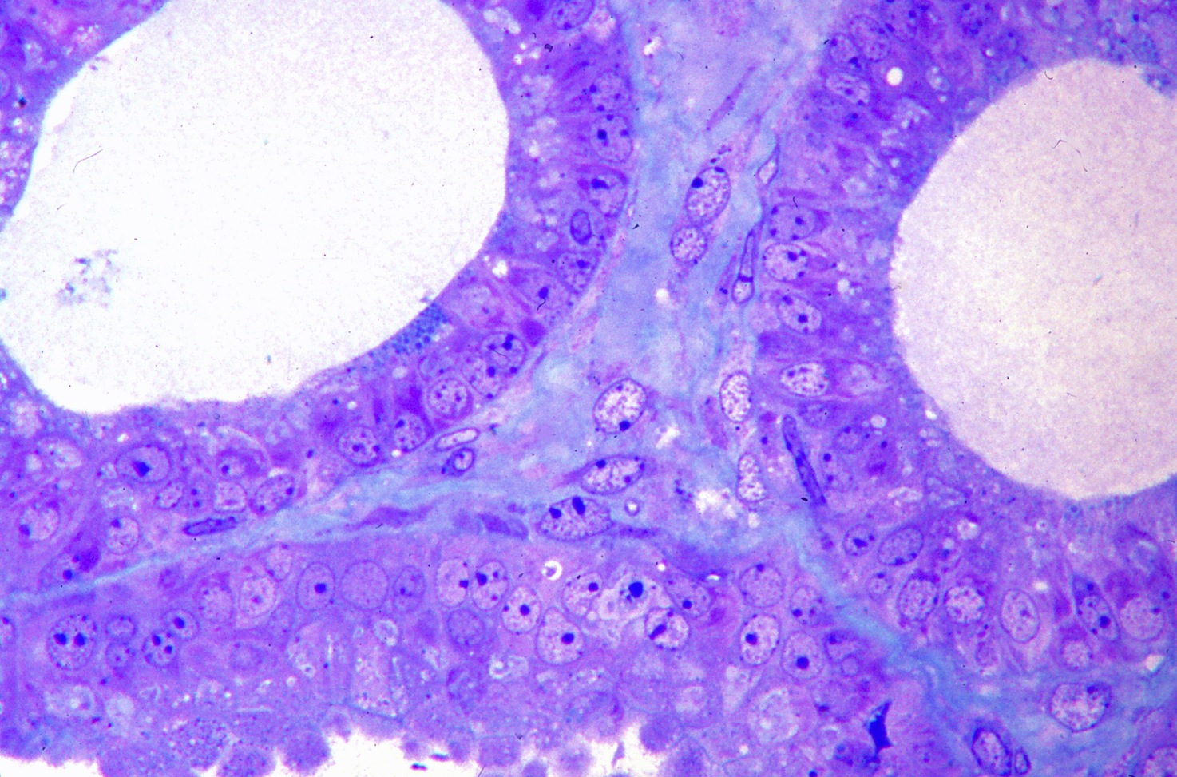
Healthy glands. Note secretion granules in the gland on the left.

Slide 11
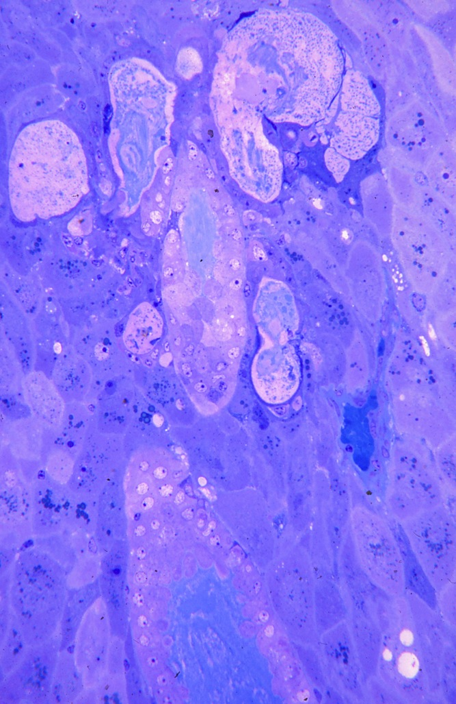
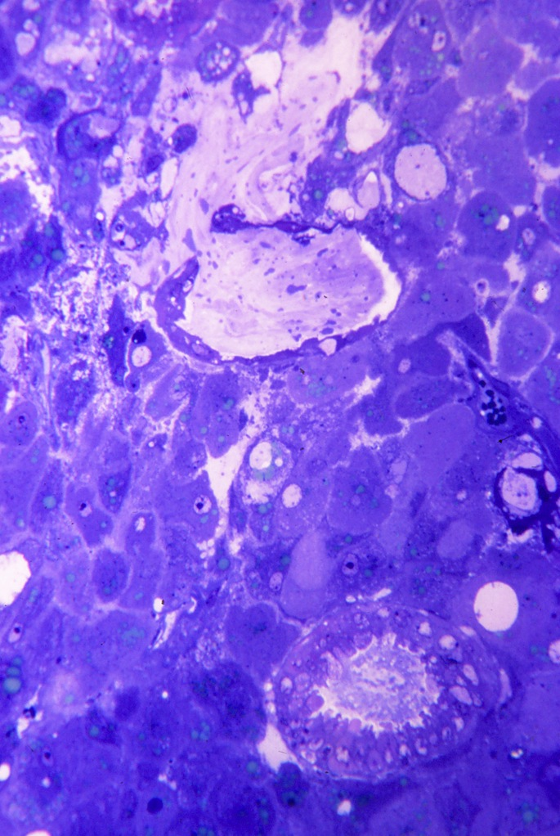
In the upper portion a gland has ruptured into surrounding tissue.
A ruptured gland in the upper center and a normal cross section below.

Slide 12
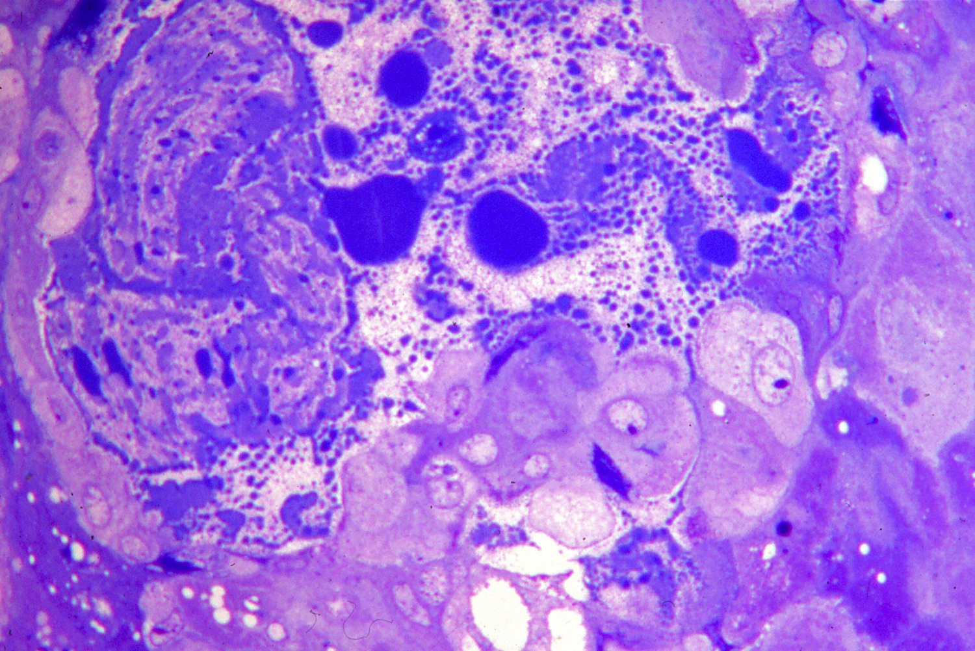
A region where gland has ruptured. Gland epithelial cells are at the left, secretion product has entered surrounding tissue to the right. Both gland rupture and vessel basal lamina thickening begin as early as 60 days; the majority of cups are not sloughed until after about 100 days.

Slide 13
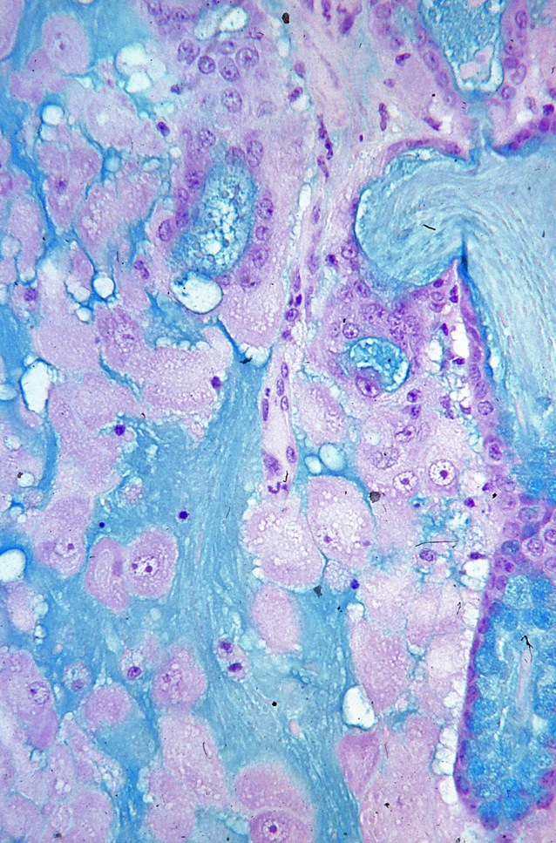
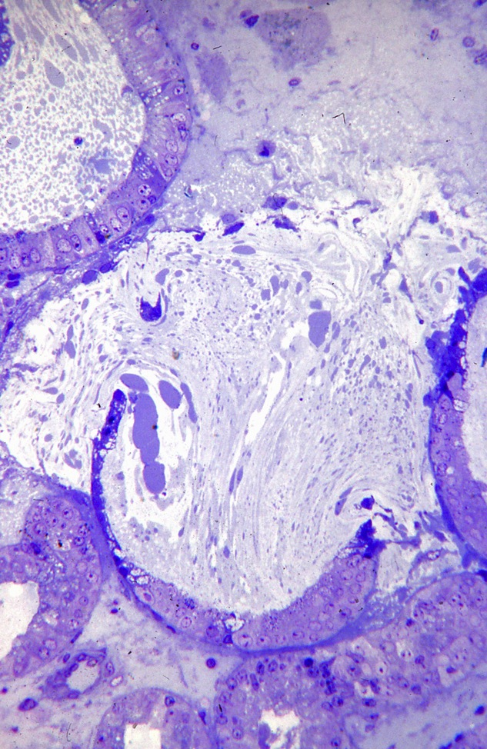
Alcian blue stain showing gland product released among cup cells on the left and in gland lumen on the right.
Gland rupture.

Slide 14
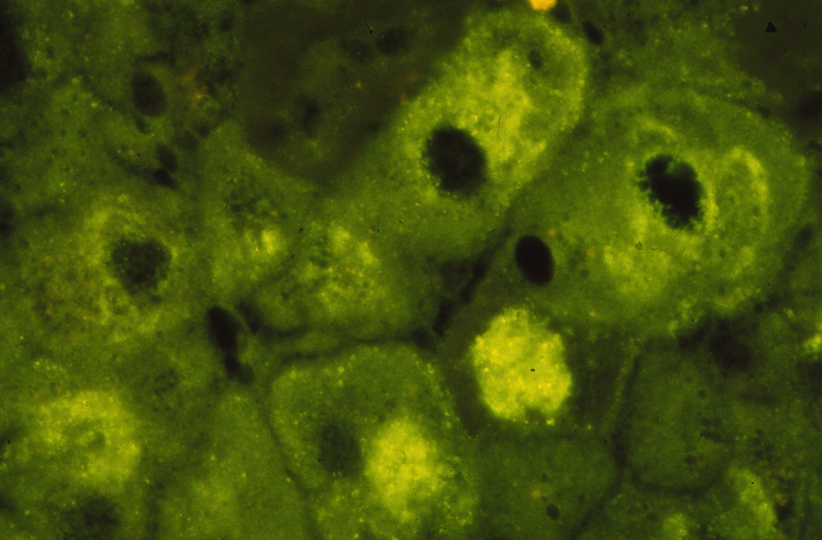
Normal cup cells show a positive reaction to antibodies to eCG, especially in the Golgi region.

Slide 15
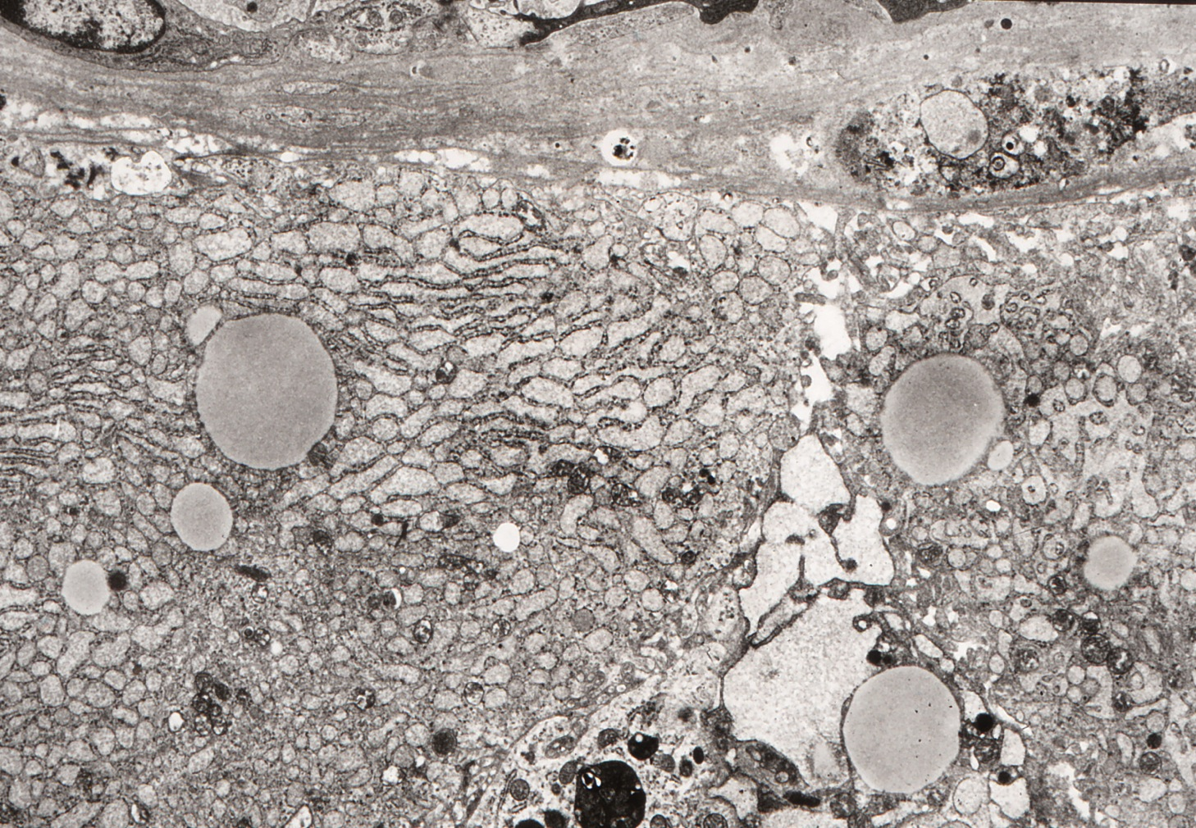
Two cup cells underlying the basal lamina of a vessel.

Slide 16
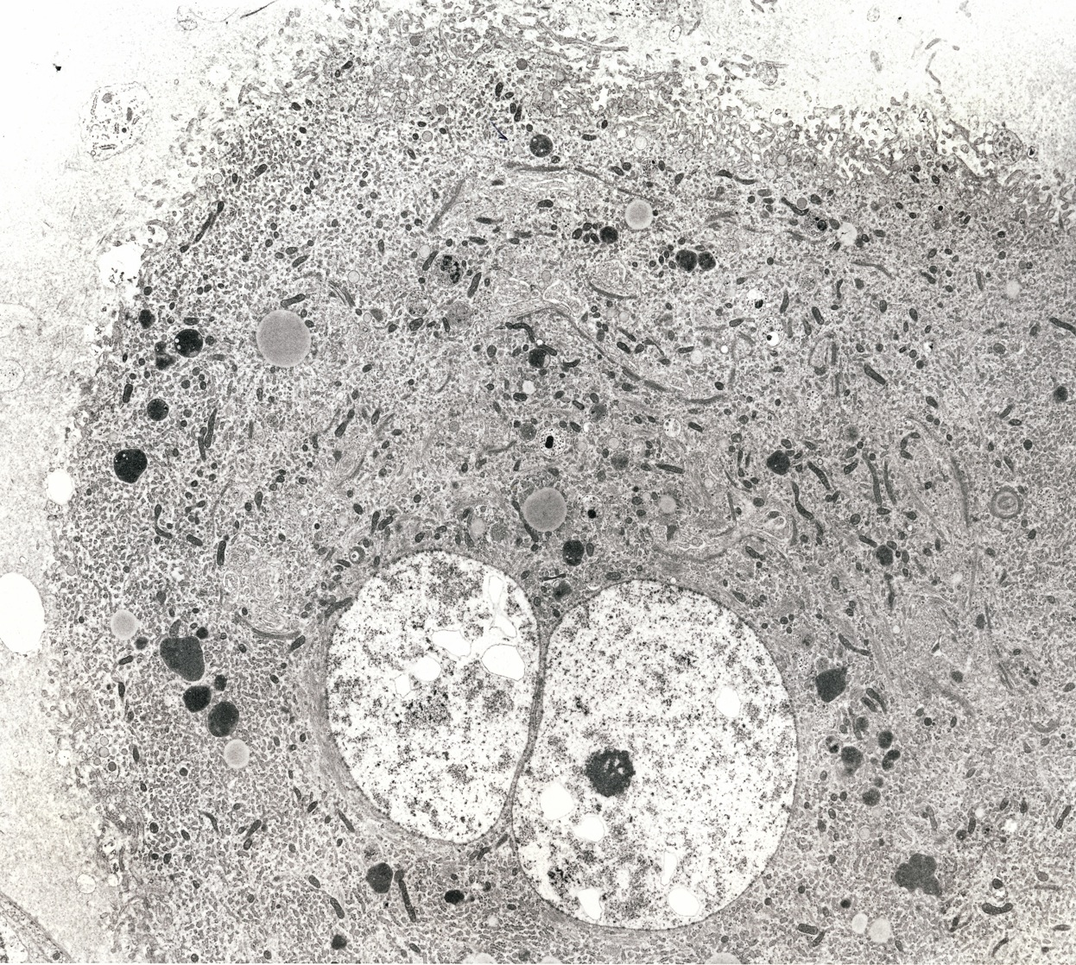
A healthy cup cell.

Slide 17
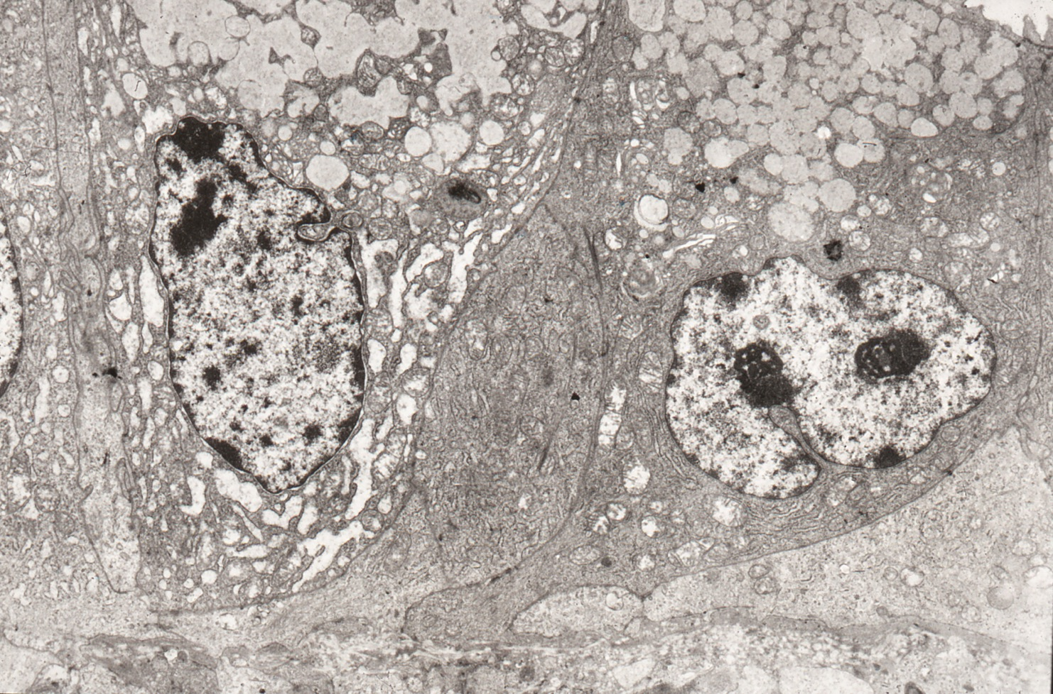
These gland cells have an accumulation of pale apical granules.

Slide 18
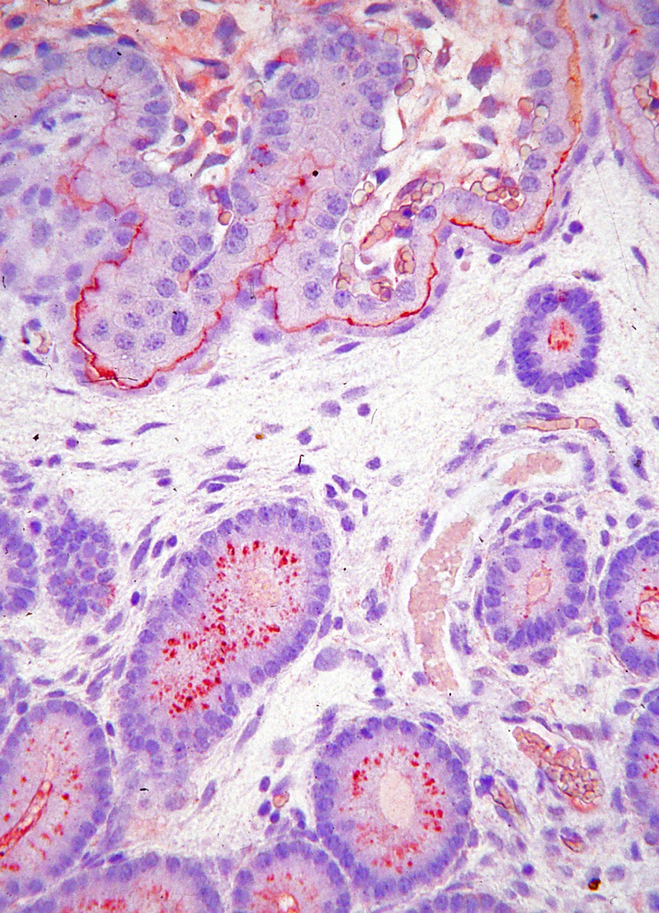
TGFa is in apices of gland cells below and between allantochorionic trophoblast and flattened uterine luminal epithelium, but not in the endometrial stroma.

Slide 19
Day 83
Degeneration of cups is a progressive phenomenon, with healthy areas, areas of gland rupture, areas of cup cell degeneration and increase in lymphocytes. The majority of endometrial vessels within the cups have thickened basal laminas. All of these factors precede sloughing.

Slide 20
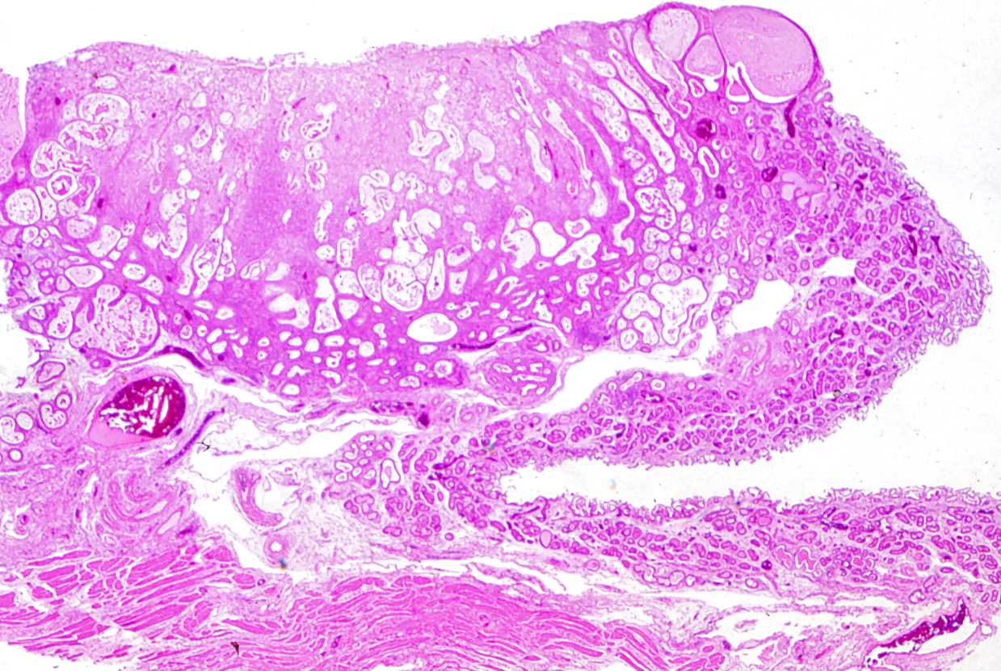
While the glands in the noncup area on the right appear normal, glands within the cup are swollen and sometimes ruptured.

Slide 21
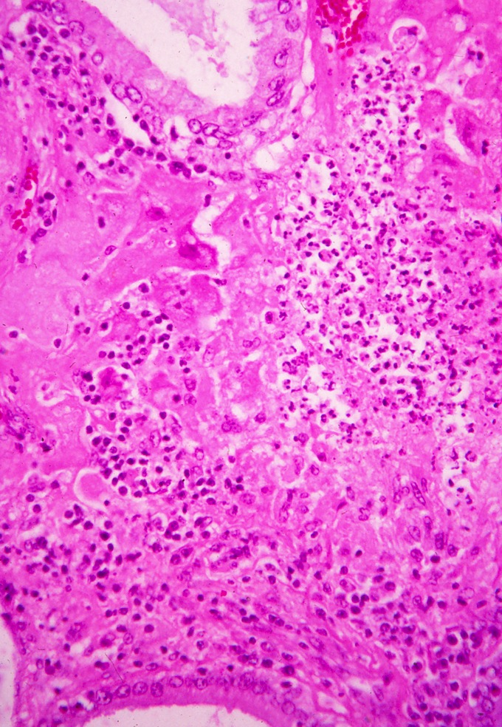
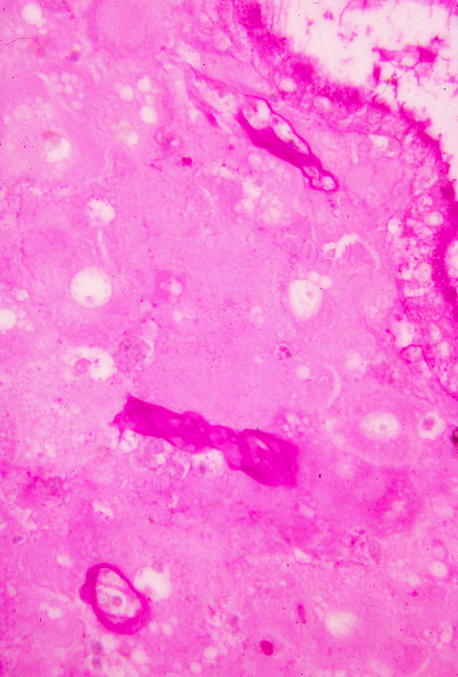
A normal gland at the top and bottom, with lymphocytic infiltration in the center, and cup cells at the margins.
PAS staining of apical granules of the gland on the right, and thick basal lamina of three vessels.

Slide 22
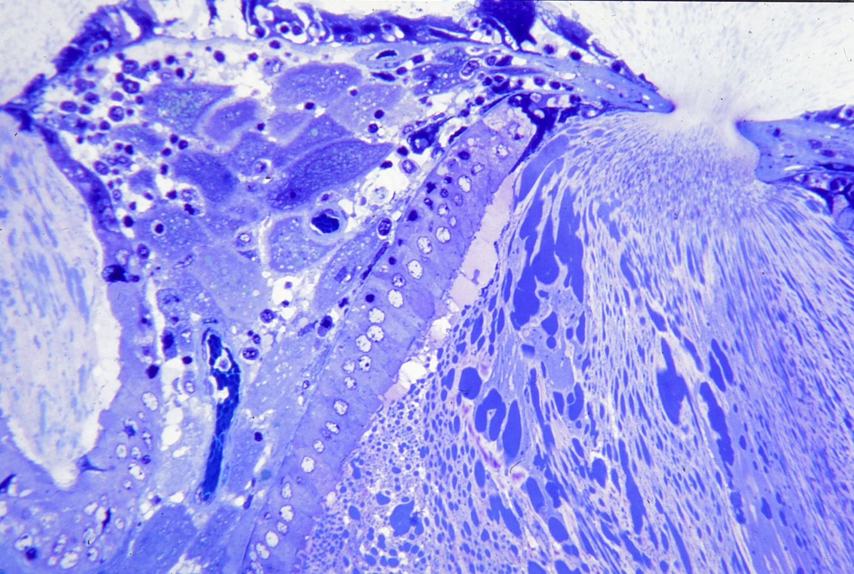
Opening of two glands onto the surface of the cup.
Note accumulation of heterogeneous secretion product.

Slide 23
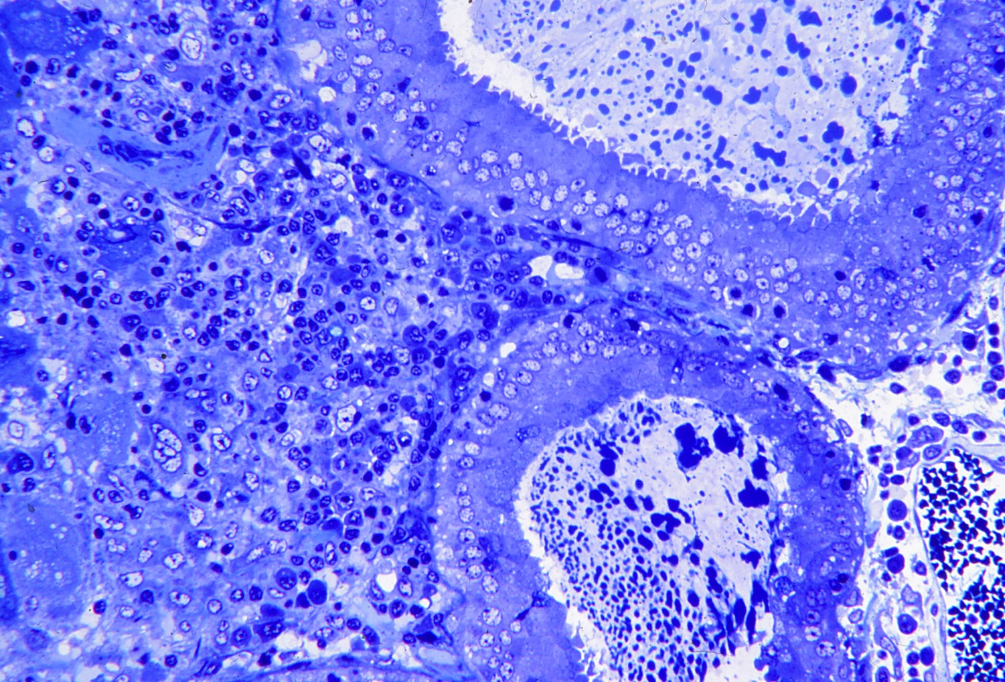
Region with normal glands and extensive lymphocytic infiltration.

Slide 24
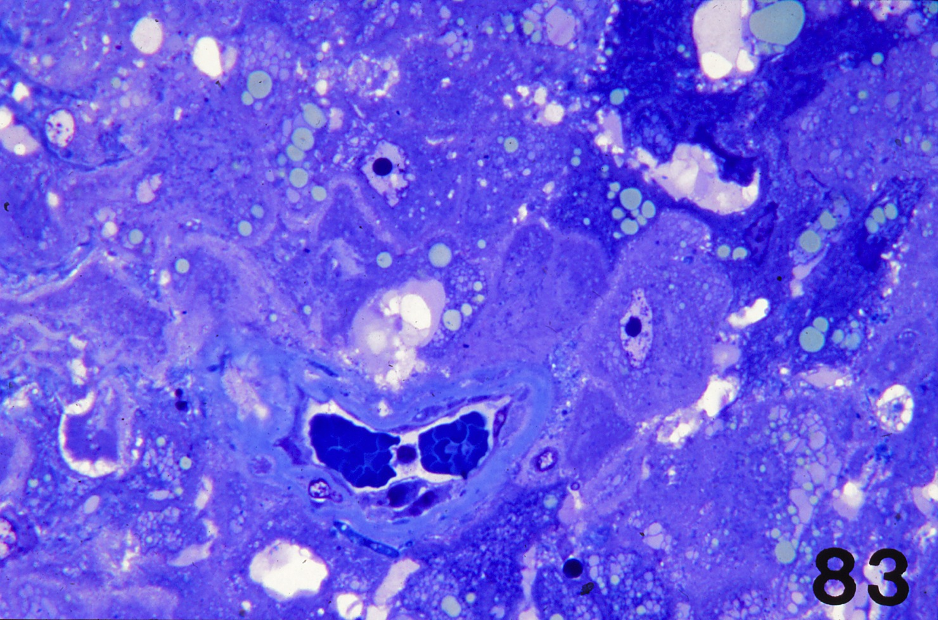
Note the thickened basal lamina around the blood vessel. Most of the cup cells are normal, but some with lipid droplets appear shrunken.

Slide 25
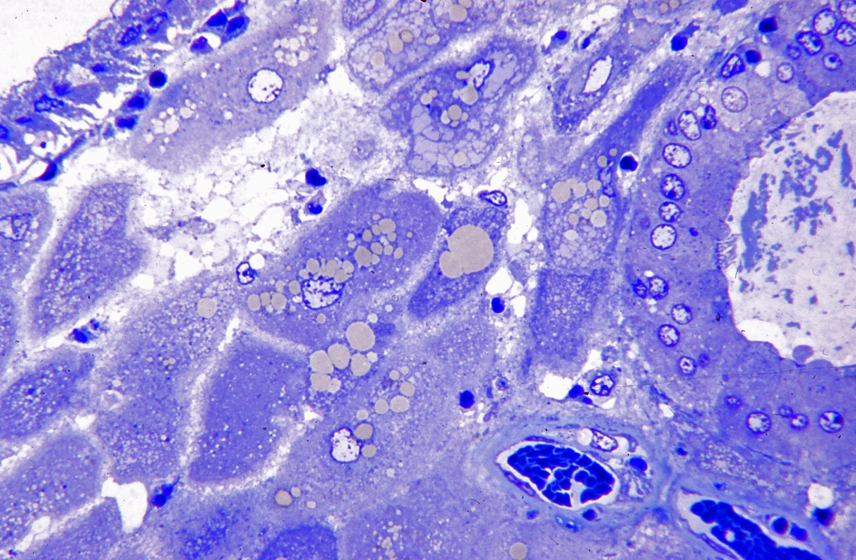
The gland epithelium in the upper left is becoming vacuolated. The cup cells are accumulating lipid droplets. The basal lamina of vessels in the lower right are thickened. This area does not show lymphocytic infiltration.

Slide 26
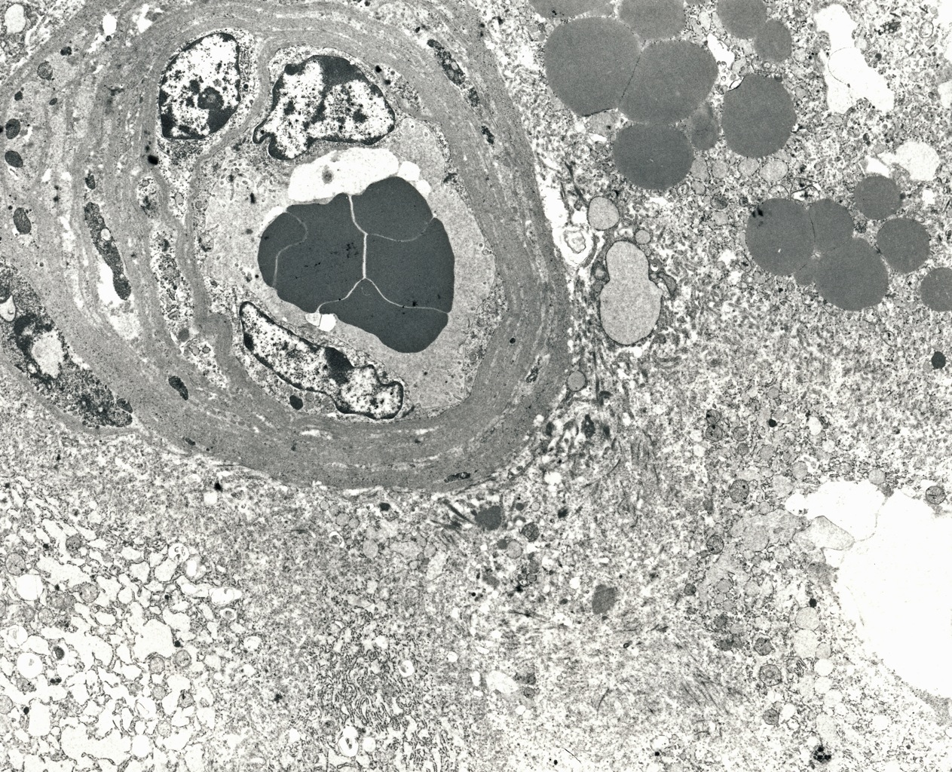
An endometrial vessel in the upper left shows multiple layers of basal lamina-like material outside of the endothelium.

Slide 27
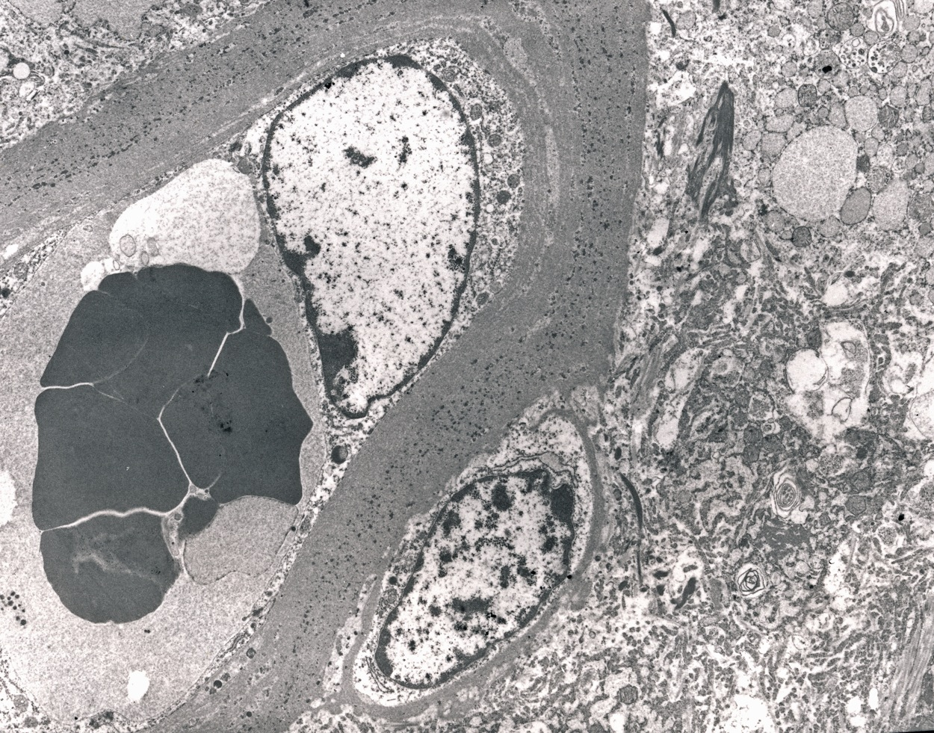
In this endometrial vessel the basal lamina is extraordinarily thick, further increasing the distance from the maternal erythrocytes to the surrounding cup cells.

Slide 28
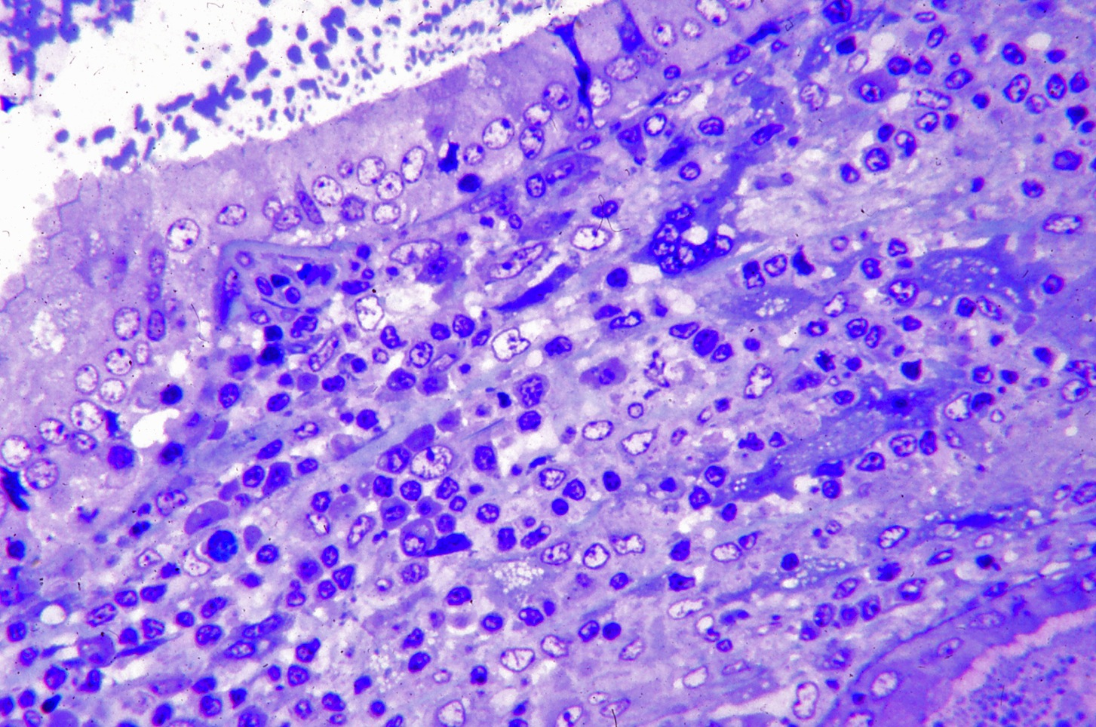
Some lymphocytic infiltration and variation in cup cell morphology.

Slide 29
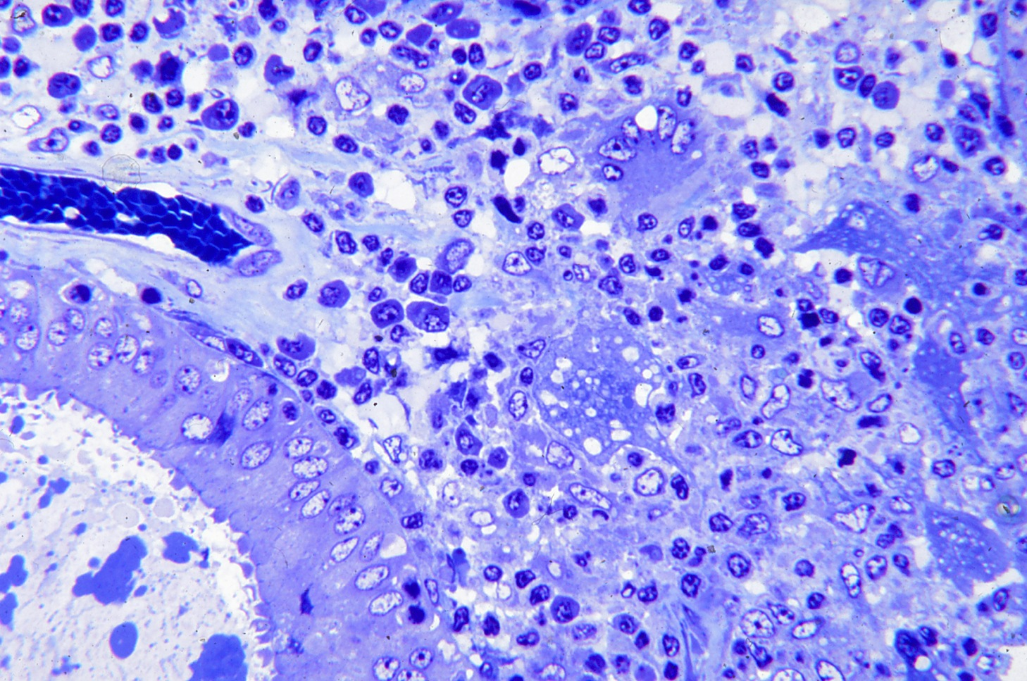
Foreign body giant cells, suggesting that there is a reaction to degeneration of cup cells and glands within the cup. However the gland in the lower left is normal.
The capillary in the nearby endometrium does not have a thickened basal lamina.

Slide 30
1995 Enders, A.C., K.C. Lantz, S. Schlafke and I.K.M. Liu. New cells and old vessels: the remodeling of the endometrial vasculature during establishment of endometrial cups. In: Equine Reproduction VI, Biology of Reproduction Monograph Series 1: 181-190.
1999 Jones, C.J.P., A.C. Enders, R.B.P. Wooding, V. Dantzer, R. Leiser and R.W. Stoddart. Equine placental cup cells show glycan expression distinct from that of both chorionic girdle progenitor cells and early microcotyledonary trophoblast. Placenta 20:347-360.
2000 Enders, A.C., C. J. Jones, K.C. Lantz, S. Schlafke and I.K.M. Liu. Simultaneous exocrine and endocrine secretion: trophoblast and glands of the endometrial cups. In: Equine Reproduction VII. Journal of Reproduction and Fertility, Suppl. 56: 615-625.

