Slide 1
Implantation in the laboratory rat
Allen C Enders
Department of Cell Biology and Human Anatomy
University of California, Davis
The morphology of implantation in the rat has been extensively studied, including by the people in our laboratory- papers listed below.
The series included here is put together to show the time sequence of development of the implantation chamber, and especially to make available color micrographs of the different stages rather than describing these stages in great detail. The Sprague-Dawley rats used were on a light cycle of 14 hr light, 10 hr dark. The day in which sperm were found in the vaginal smear was considered day 1 of pregnancy.
The implantation sites for this study were obtained by perfusion of the uterus with saline, then fixative, via the abdominal artery in anesthetized animals.

Slide 2
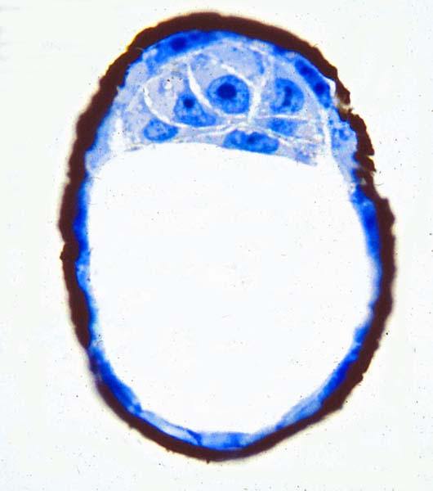
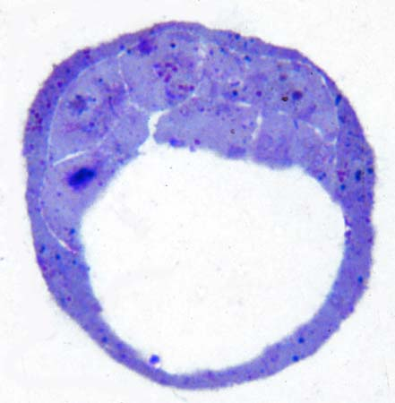
Day 5 of pregnancy
Counting the day of sperm found in vagina as day 1, on day 5 the blastocyst loses its zona pellucida. The blastocyst is situated centrally but, because of the change in shape of the uterine lumen, this is considered to be antimesometrial. The lumen is largely closed but blastocysts are readily flushed.
On the morning of day 5 the thick zona pellucida is stained heavily by concanavalin A-peroxidase. Note that the endoderm has not yet migrated parietally.
On the afternoon of day 5 the zona pellucida is lost from the blastocysts. There is still little differentiation of endoderm.

Slide 3
Day 6
By the morning of day 6, the blastocyst is clasped but the uterine epithelium is intact. The primary decidua is well-developed immediately around the blastocyst, separating the maternal vessels from the implantation chamber.
Within the blastocyst the endoderm begins to migrate parietally.
By the afternoon of day 6, apposition of trophoblast to uterine epithelium is sufficient that flushing becomes more difficult. In lightly fixed split uteri, some of the trophoblast sticks to the uterine surface on either side, resulting in splitting of the blastocyst.

Slide 4
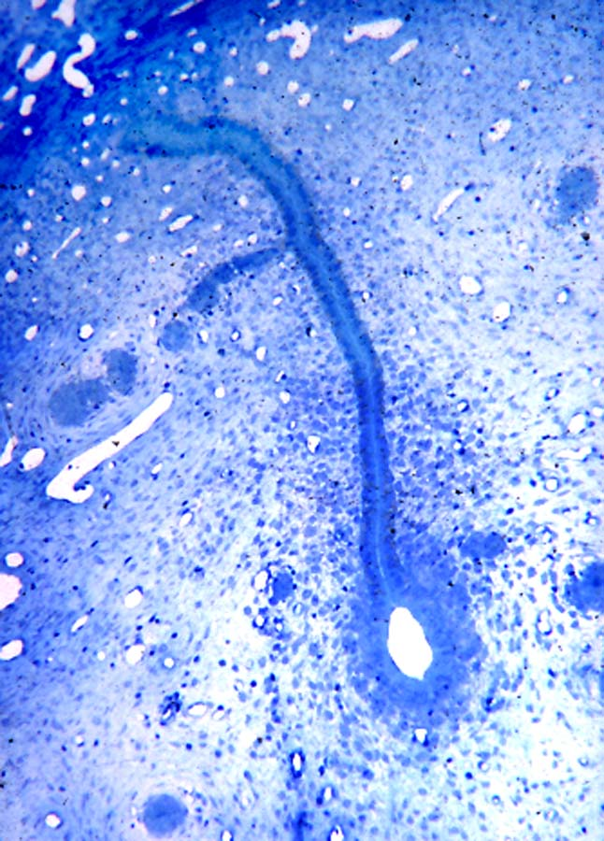
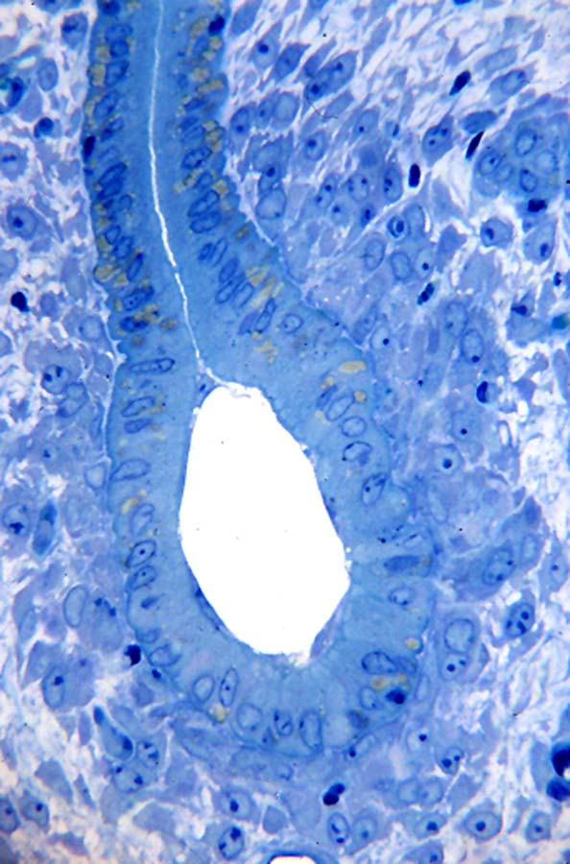
On the morning of day 6 the lumen is closed and there is some differentiation of primary decidua around the clasped blastocyst.
At a higher mag the differentiating decidua is clear.

Slide 5
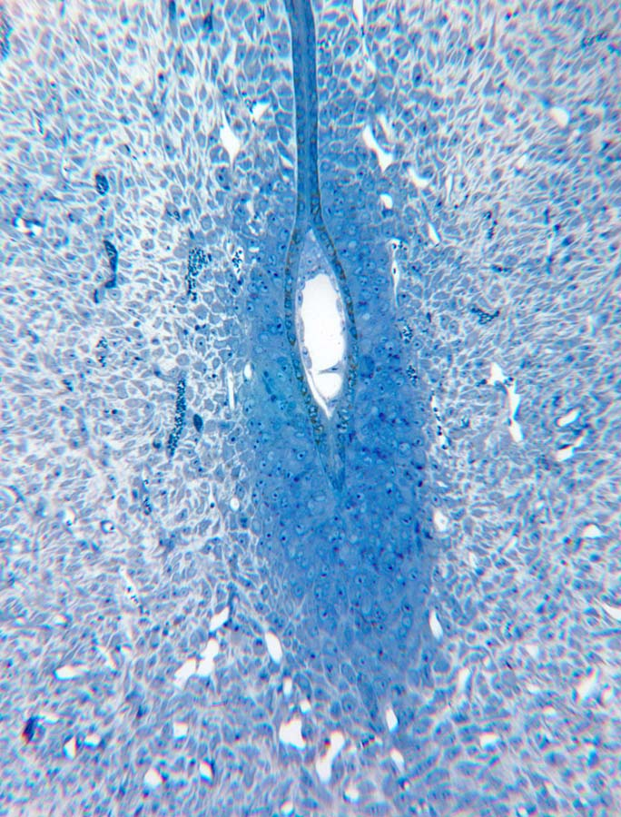
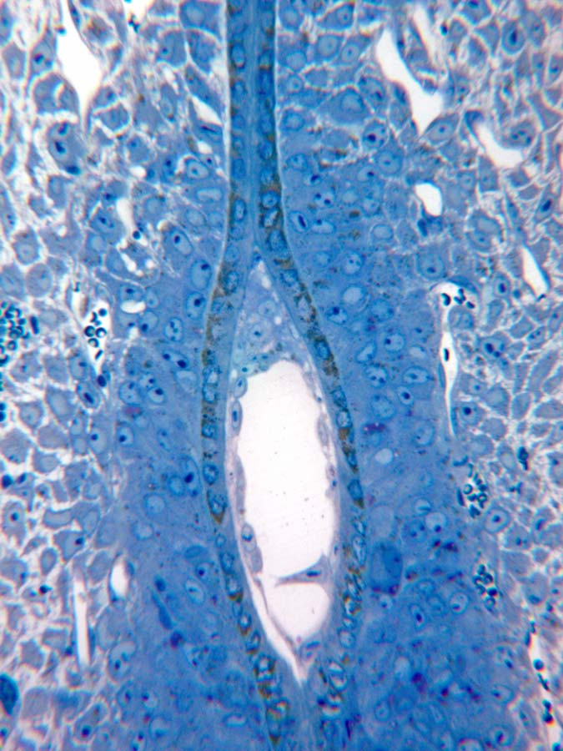
On the evening of day 6 there is considerably more decidual differentiation, especially antimesometrially.
At a higher mag it can be seen that the luminal epithelium is still intact, but the blastocyst is elongating. There is some endodermal migration.

Slide 6
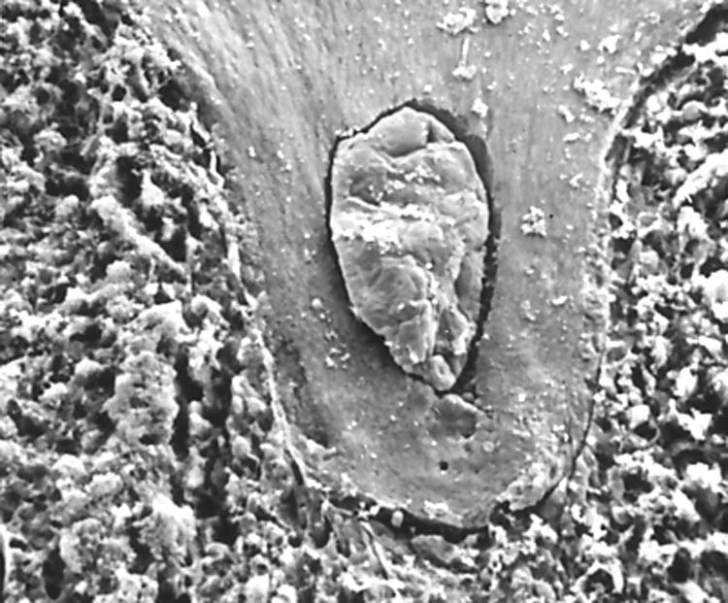
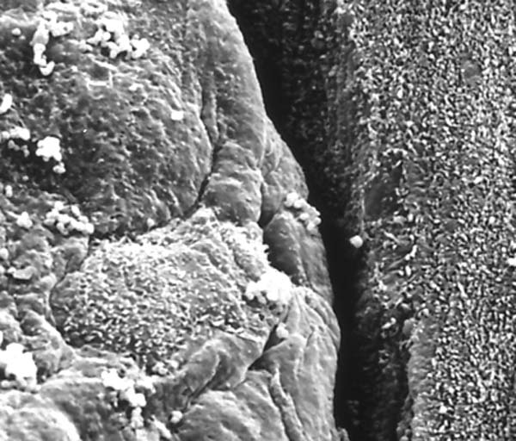
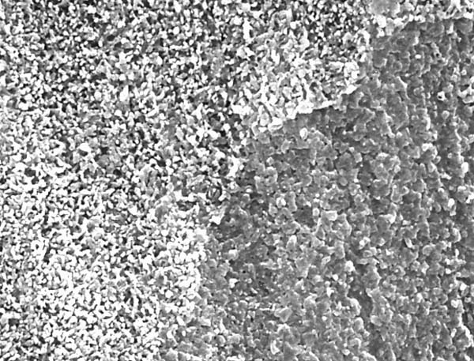
A split uterus shows the shape of the implantation chamber surrounding the blastocyst.
Margin of the blastocyst on the left, uterus on the right.
Where the blastocyst has been apposed to the uterine epithelium on the right, the nature of projections from uterine epithelial cells is changed to a blunter form.

Slide 7
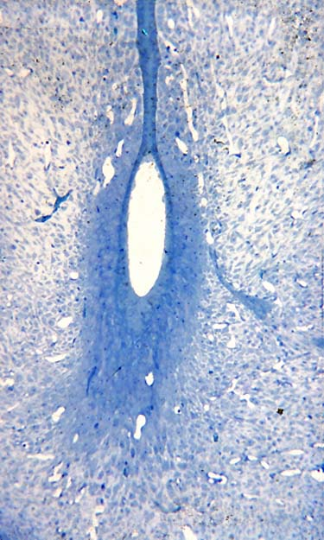
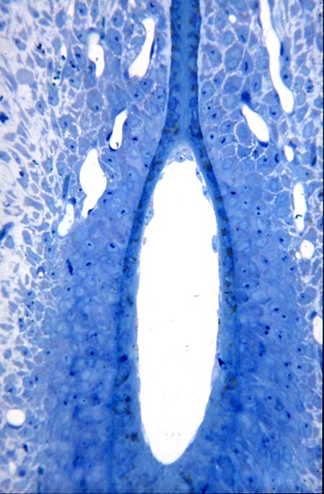
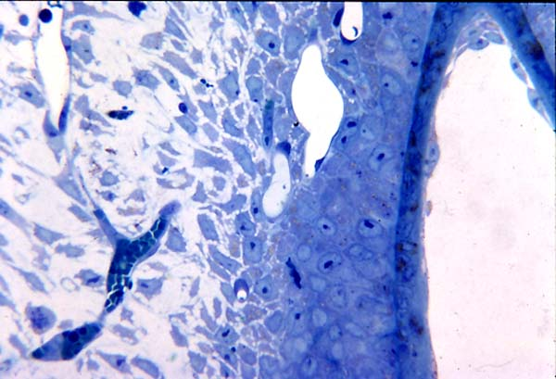
The primary decidua intervenes between the luminal epithelium and the endometrial vessels.
Evening day 6 site. The section does not go through the inner cell mass.
Note the migrating endodermal cells in the upper right.

Slide 8
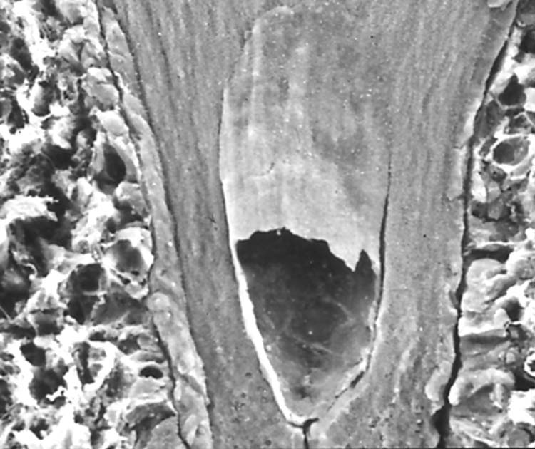
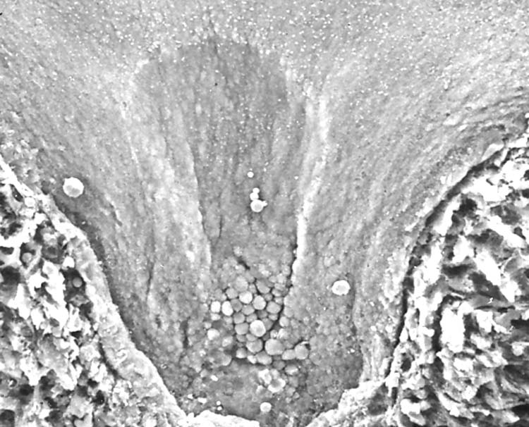
By the evening of day 6 the adherence of trophoblast to endometrium is such that in split scanned preparations the trophoblast may be torn.
An imprint left from a blastocyst, evening of day 6.

Slide 9
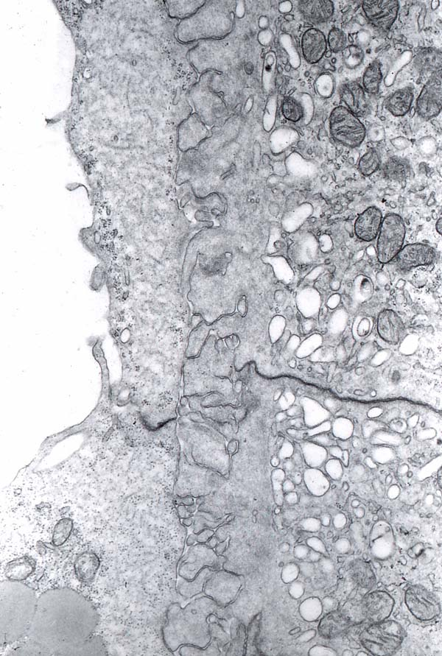
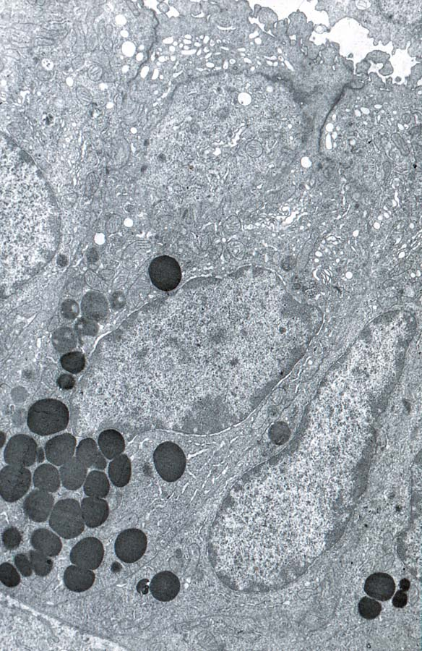
The intimate apposition of trophoblast, left, to luminal epithelial cells, right.
The uterine epithelium at this stage may still have basal lipid droplets.

Slide 10
Day 7
On the morning of day 7, the integrity of the uterine epithelium adjacent to the mural trophoblast is lost. The implantation site begins to be tubular, and the inner cell mass elongates to form the egg cylinder.
By the afternoon of day 7, the epithelium is gone on either side of the mural trophoblast.
By the evening of day 7, some of the epithelium well above and separated from the site begins to disintegrate in the area that will be come the mesometrial chamber. Decidualization is much more extensive than the previous day, and some maternal blood reaches the mural trophoblast.

Slide 11
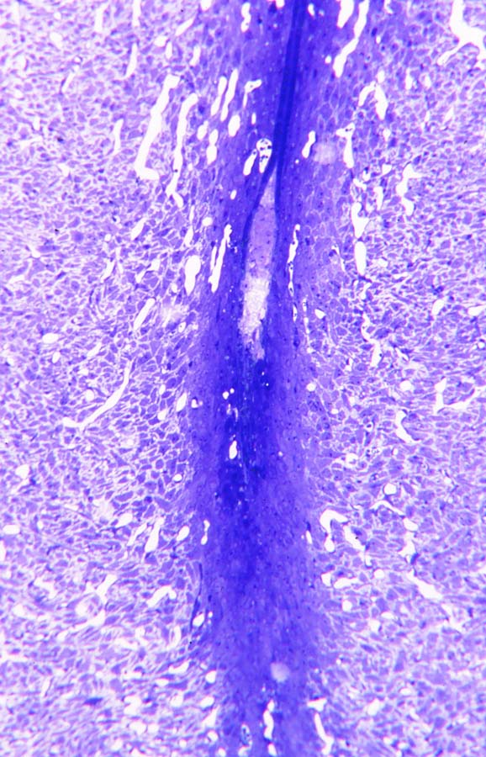
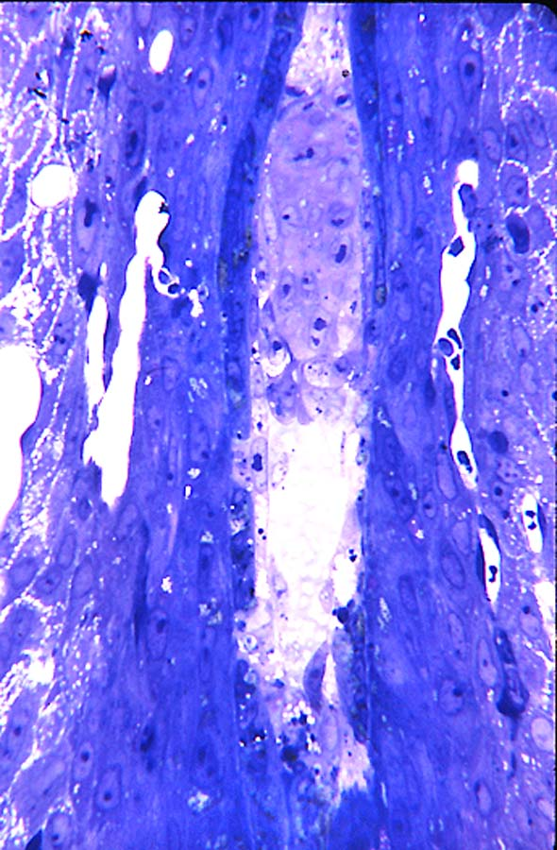
There is a pronounced egg cylinder on the morning of day 7, and the primary decidua extends above as well as below the implanted blastocyst.
At this higher mag it can be seen that at several places in the abembryonic area the luminal epithelial cells are missing and trophoblast is adjacent to primary decidua.

Slide 12
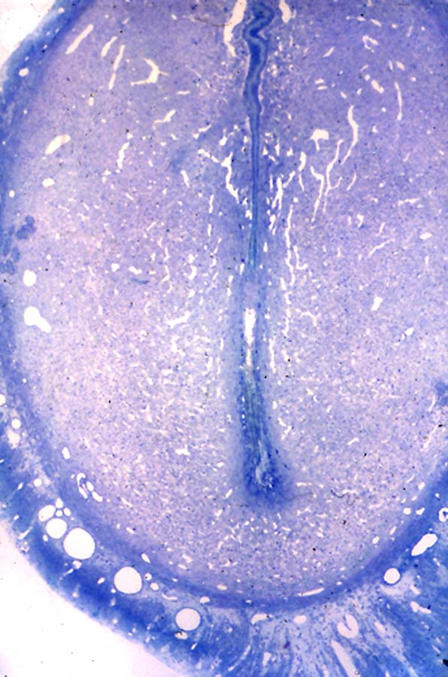
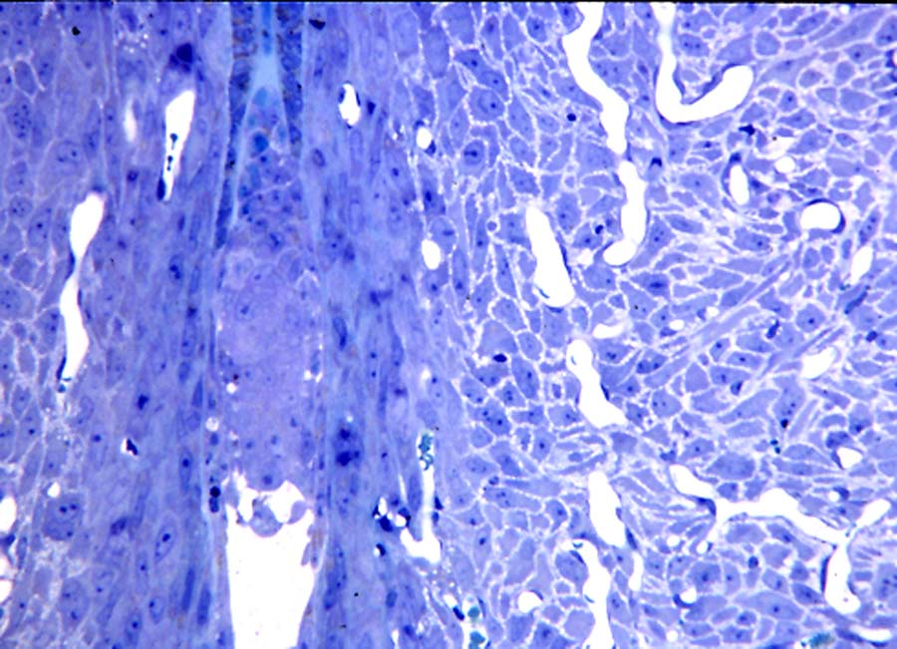
At a higher mag the luminal epithelium in the area of the ectoplacental cone is intact, but the rest of the epithelium is now gone from the level of the egg cylinder down.
The afternoon of day 7. The growth of the secondary decidua has elongated the site, but primary decidua is still intact.

Slide 13
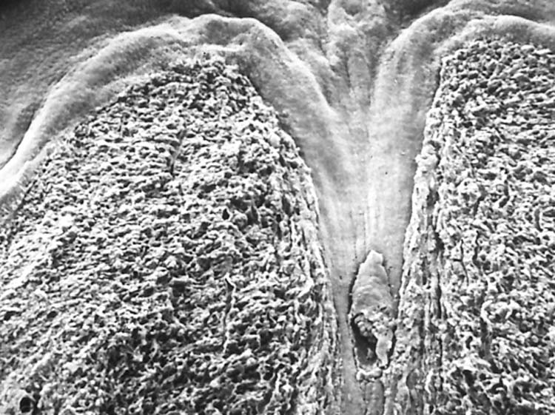
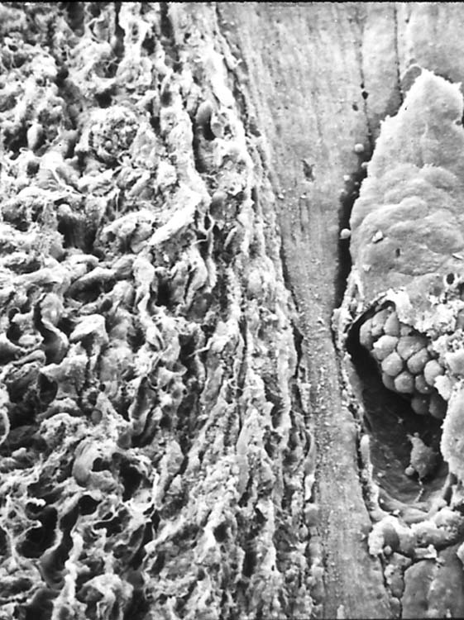
The longitudinally split uterus shows the tubular arrangement of the implantation site.
At a higher mag the domed visceral endoderm cells are seen, together with a migrating parietal endoderm cell towards the base of the blastocyst cavity.

Slide 14
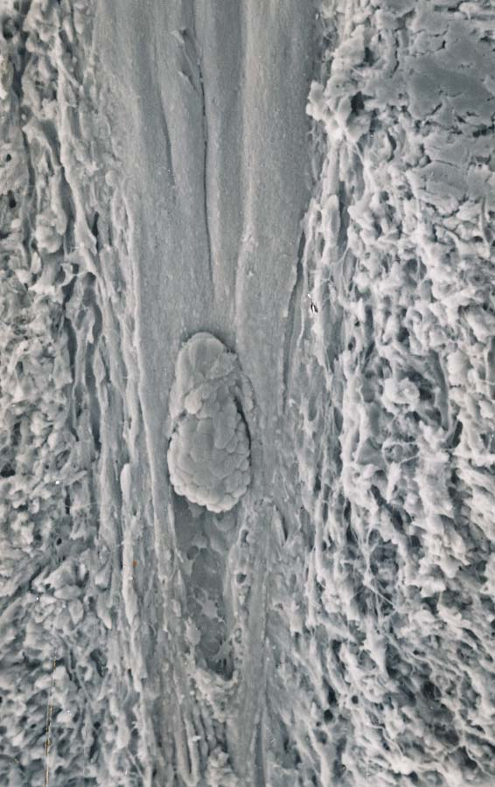
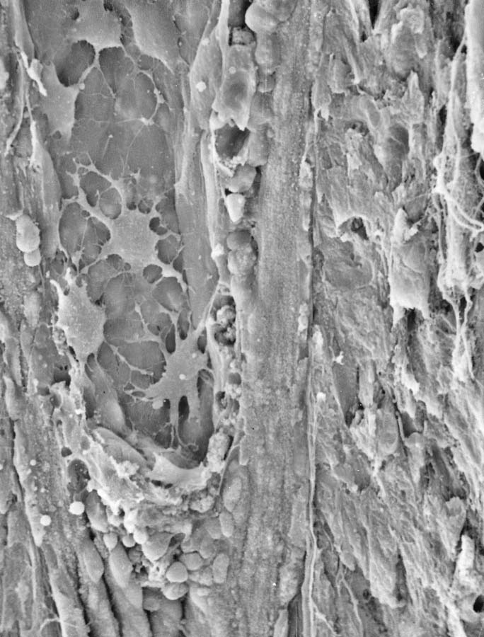
Another example of a split day 7 implantation site.
At a higher mag the stellate individual endodermal cells can be seen on the inner surface of the abembryonic trophoblast.

Slide 15
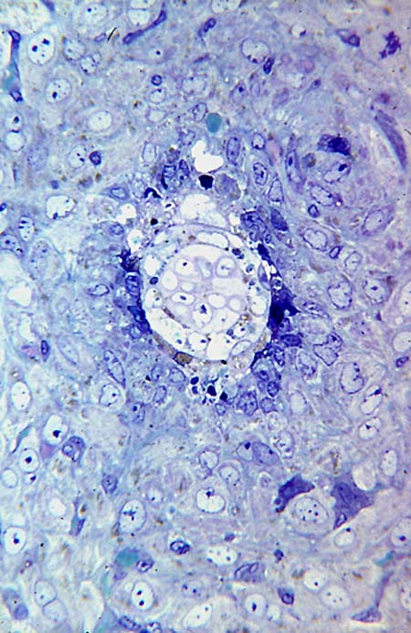
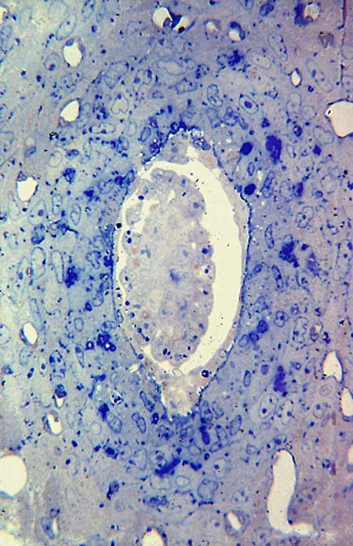
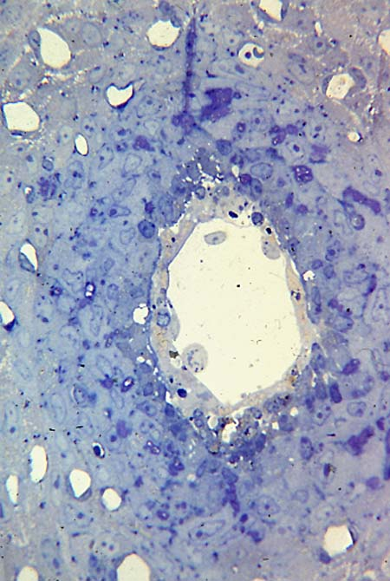
Antimesometrially parietal endoderm cells can be seen adjacent to trophoblast, which is in contact with primary decidual cells, a few of which are no longer robust. There is slight anterior-posterior elongation of the site.
Cross section across the implanting blastocyst shows the beginning of disintegration of some of the endometrial cells around the mesometrial aspect of the blastocyst.
More antimesometrially, the cross section shows trophoblast surrounding the blastocyst cavity and a layer of visceral endoderm cells around the ectoderm of the blastocyst.

Slide 16
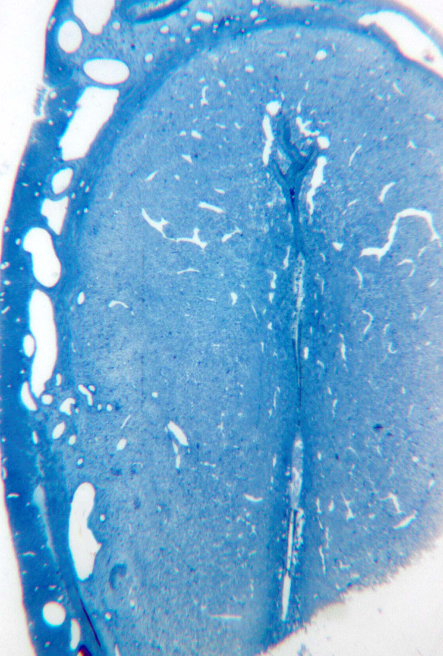
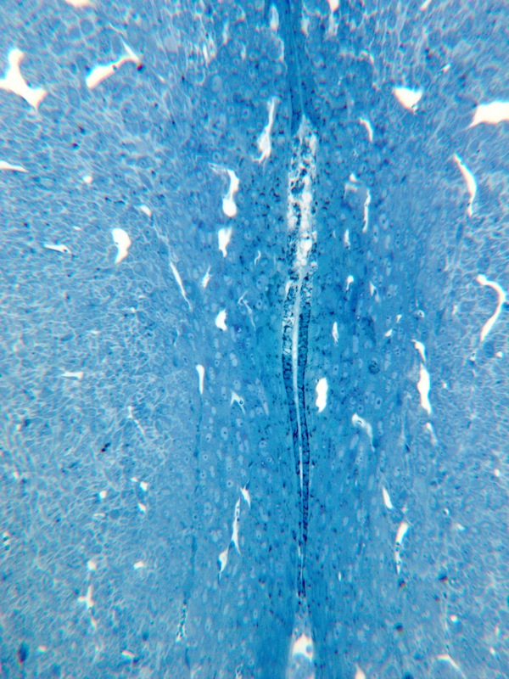
At a higher mag the disintegration is clear. Intact epithelium is between it and trophoblast below. The isolated area of disintegration is the start of the mesometrial cavity.
On the evening of day 7 the luminal epithelium begins to disintegrate some distance mesometrial to the blastocyst.

Slide 17
Day 8
By the morning of day 8, there is a fair sized mesometrial chamber. Within the egg cylinder a proamniotic cavity appears. By afternoon mesometrial growth of the decidua has resulted in the embryo being situated antimesometrially. The mesometrial-antimesometrial growth of the decidua can be seen by the orientation of cell divisions and the orientation of the banded collagen.
By the evening of day 8, the convergence of vessels in the mesometrial aspect of the decidua is evident, and some maternal blood enters the mesometrial chamber, which becomes lined by endothelial cells.
Disintegrating primary decidual cells contribute to irregular spaces between the mural trophoblast and the remaining decidua. The spaces around the blastocyst contain maternal blood.
The luminal epithelium between the ectoplacental trophoblast and the mesometrial chamber begins to disintegrate. Antimesometrially there may be some residual luminal epithelium surrounded by disintegrating primary decidual cells.

Slide 18
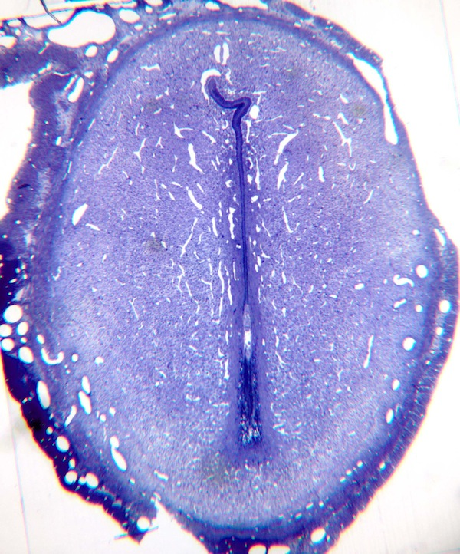
In this montage the cavity of the blastocyst can be seen above a remnant of uterine luminal epithelium, which is surrounded by disintegrating primary decidual cells in an area designated the decidual crypt.The region above the blastocyst is seen in the next panel.
By the morning of day 8 the area of implantation has grown larger but is especially elongated mesometrial-antimesometrial. The mesometrial growth tends to place the site of the implanting blastocyst more antimesometrially that it appeared originally.

Slide 19
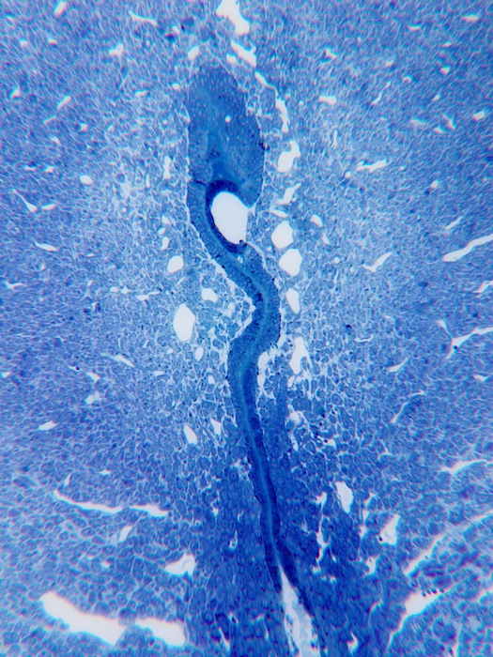
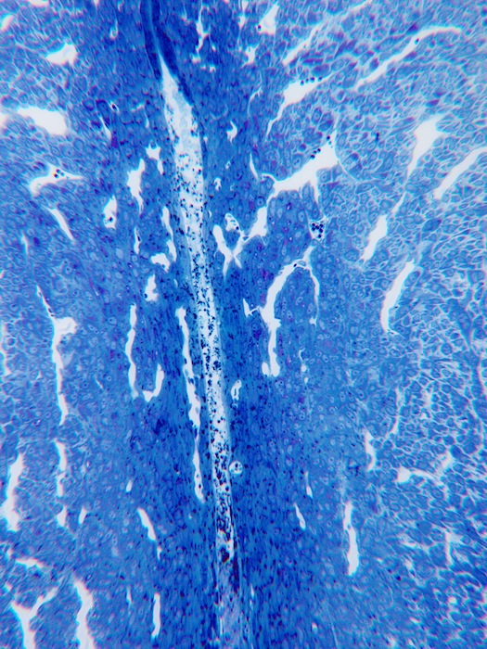
The mesometrial extreme of the uterine luminal epithelium from the previous site.
The developing mesometrial chamber shows epithelial disintegration.

Slide 20
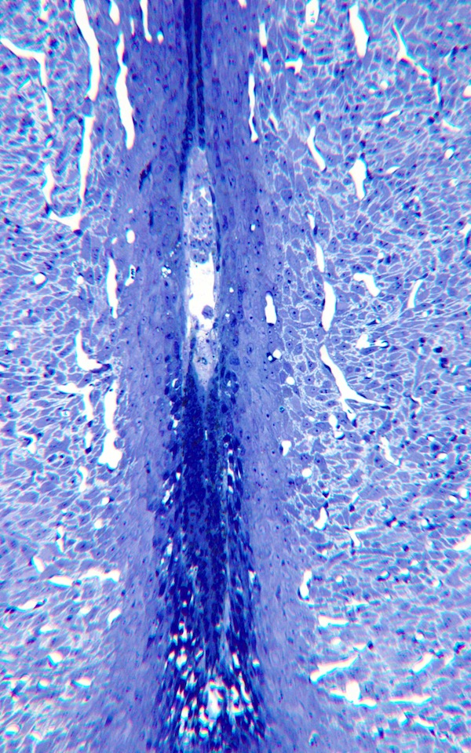
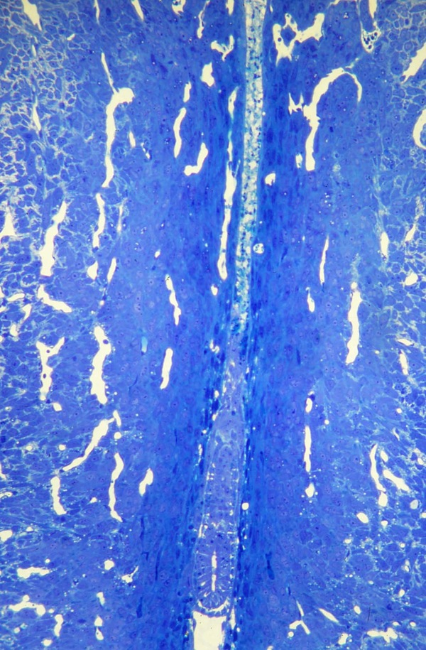
The epithelium above the ectoplacental cone is intact. Below the trophoblast, luminal epithelium remains, although the surrounding decidua is beginning to disintegrate.
Although the same age as the previous site, this site is more advanced, in that the epithelium above the ectoplacental trophoblast has disintegrated

Slide 21
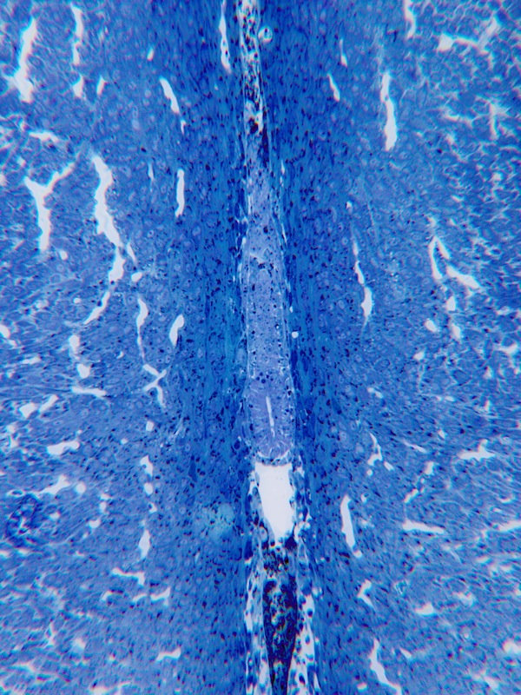
In this morning day 8 site the beginning of the proamniotic cavity can be seen as a slot within the ectoderm of the implanted blastocyst

Slide 22
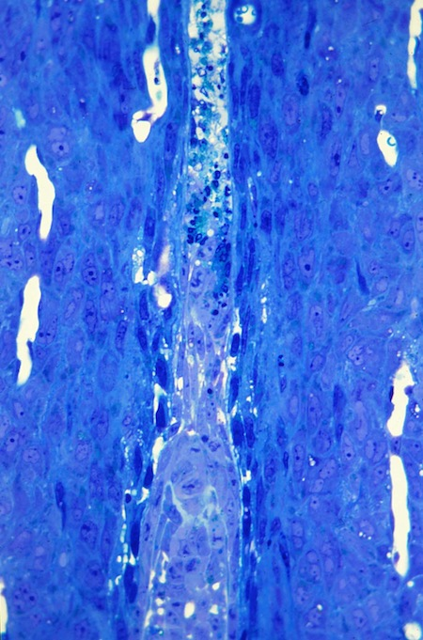
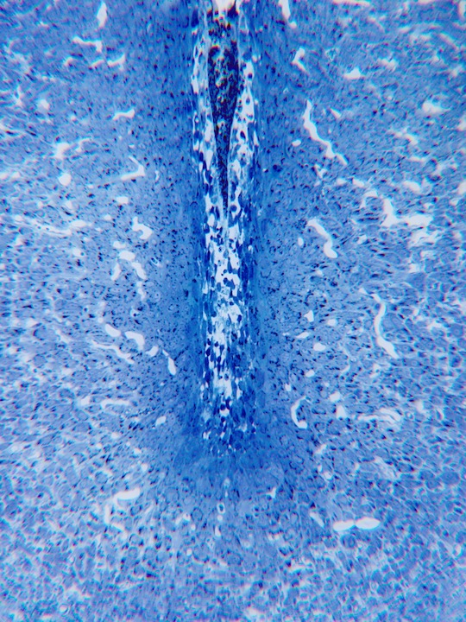
In the decidual crypt, the primary decidua has disintegrated. Some residual epithelium is seen towards the top of this micrograph. However the presence of remaining epithelium is variable.
The beginning of disintegration of the primary decidua can be seen adjacent to the trophoblast,

Slide 23
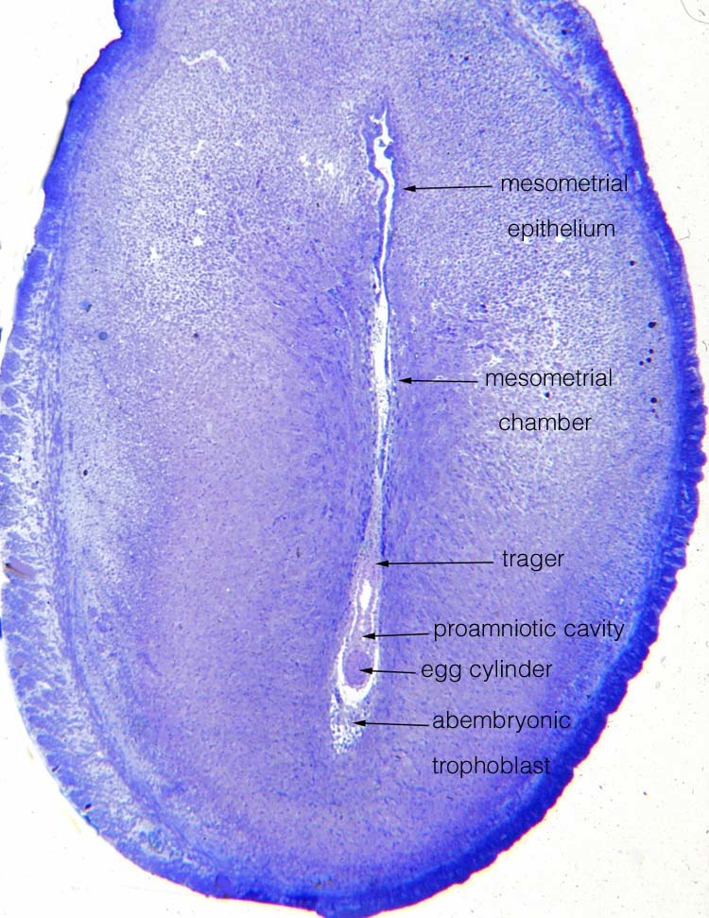
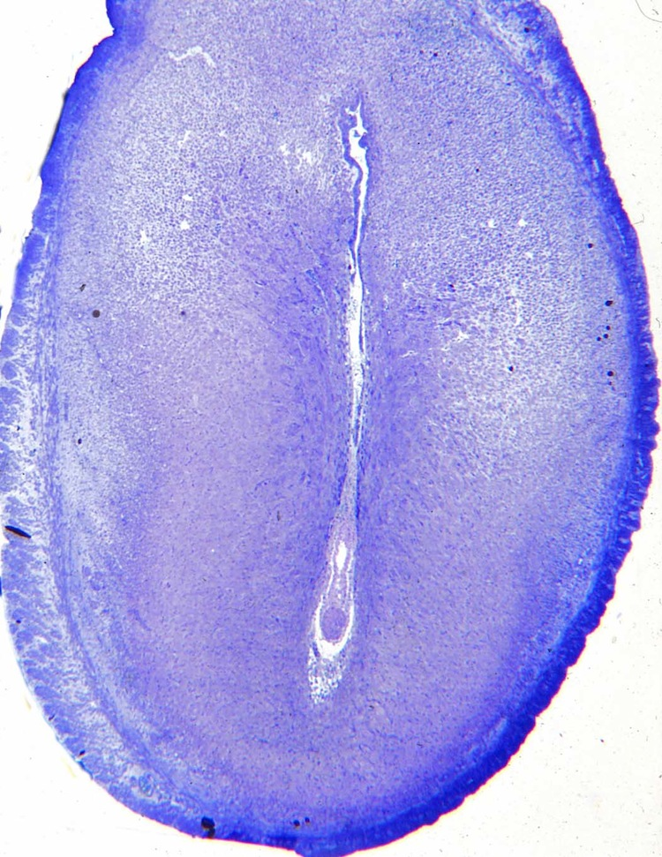
On the afternoon of day 8 the width of the area with the blastocyst is increasing.

Slide 24
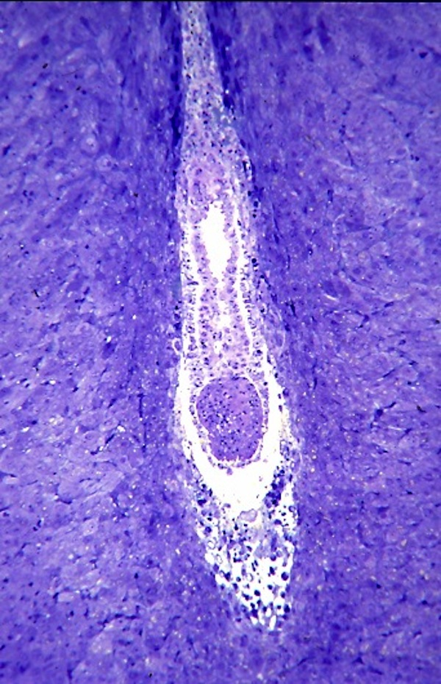
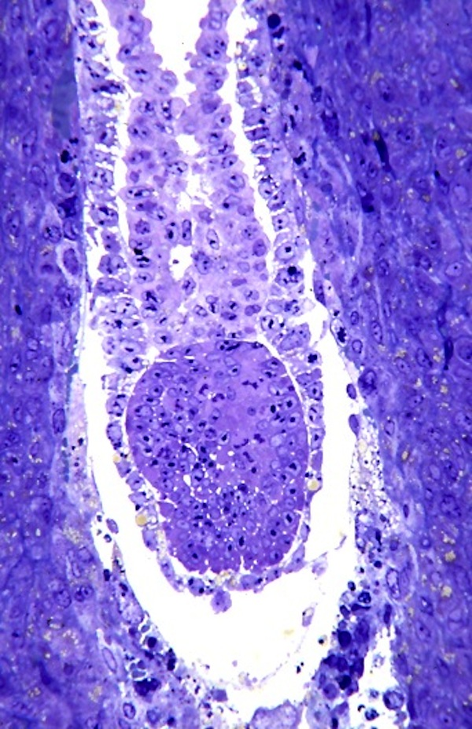
Although this section is through the middle of the site, the embryonic ectoderm is at an angle, appearing as a ball rather than a tube.
Higher mag, the endodermal cells adjacent to the cells of the ectoplacental cone are more cuboidal than those adjacent to the embryonic ectoderm.

Slide 25
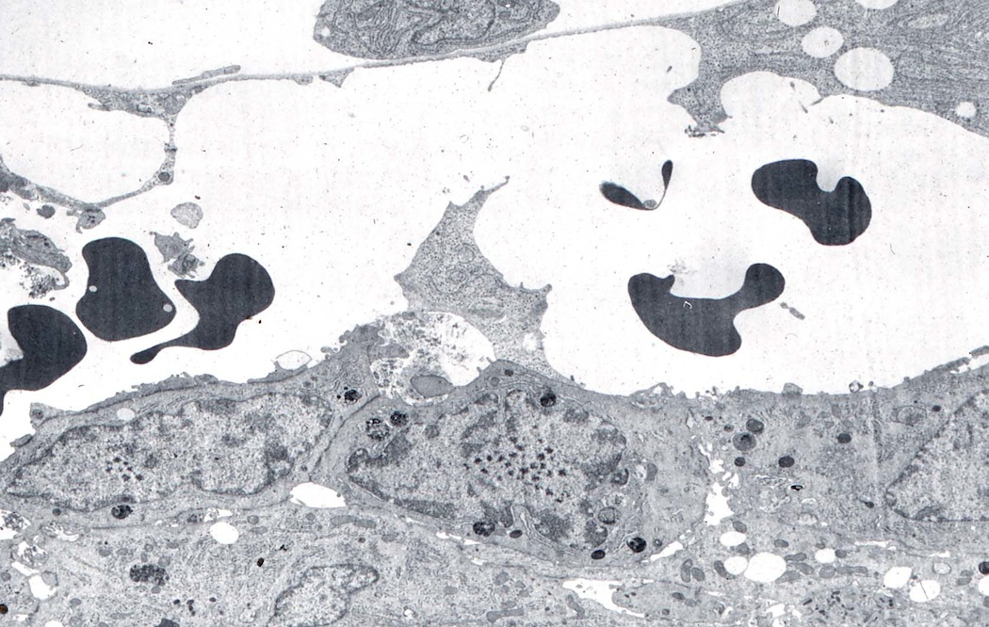
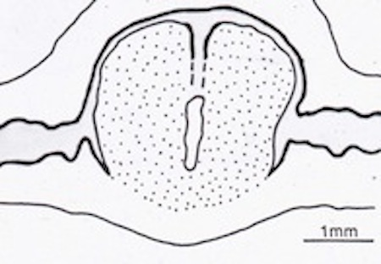
Diagram of a longitudinal section thru the uterus and site, to show the way in which the decidua bulges towards the mesometrium at this stage
At the top is a parietal endoderm cell. The trophoblast then encompasses a space which maternal blood has entered. Decidual cells are below. (side of implanting blastocyst)

Slide 26
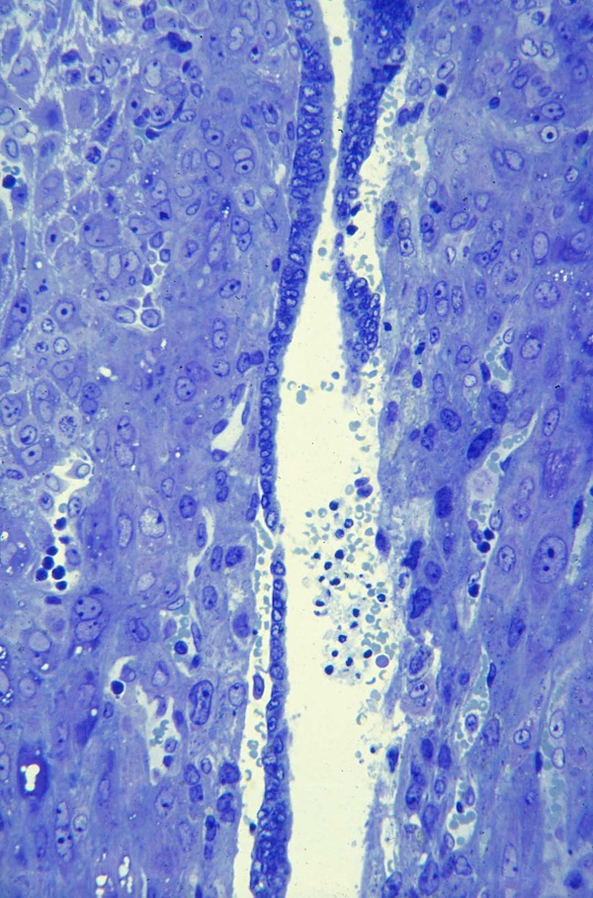
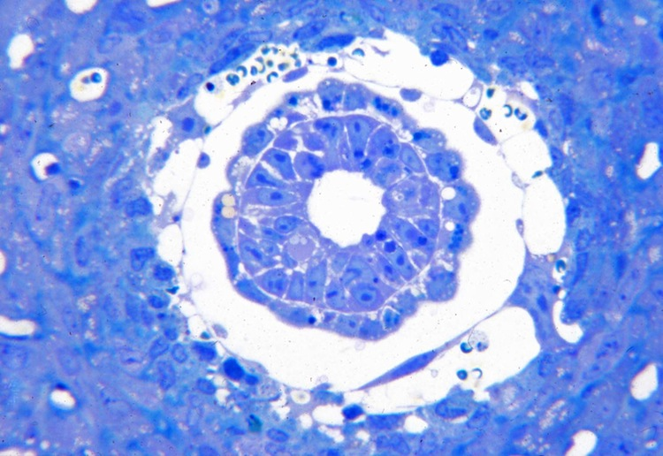
A cross section of the implanting blastocyst. In the center is the proamniotic cavity. Surrounding the embryonic ectoderm is the visceral endoderm. The yolk sac then shows a space with few small parietal trophoblast at its margin. The surrounding area with a few maternal blood cells is encompassed by trophoblast giant cells, which abut the decidua.
Developing mesometrial chamber. The epithelium has disintegrated on the right, and loosened on the lower left. These changes are occurring well away from the trophoblast of the ectoplacental cone.

Slide 27
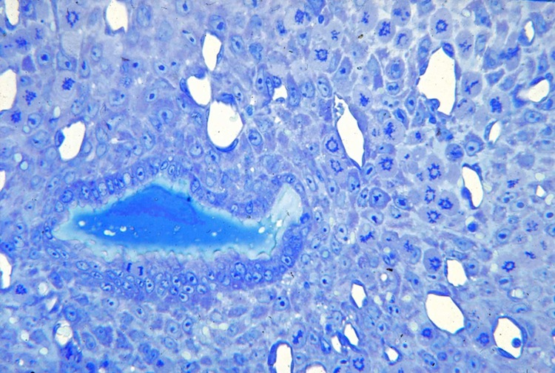
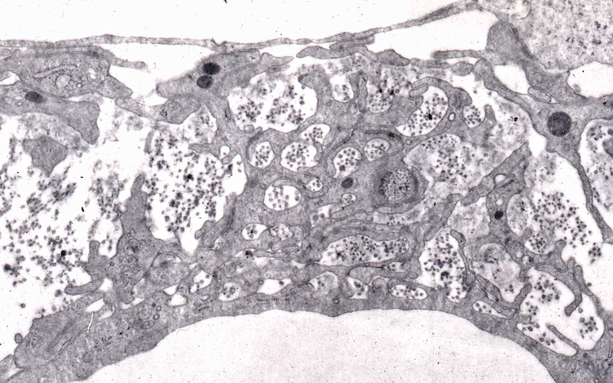
A polar view of a colchicine prep that is a cross section of the area of epithelium and decidua directly above the implanting blastocyst. Note that most of the arrested metaphase stages show a hollow center, indicating that the cell division will be mesometrial-antimesometrial, elongating the site.
The bundles of collagen within the trophoblast are also oriented mesometrial-antimesometrial as seen by the fact that they are cut across in this cross section through the site.

Slide 28
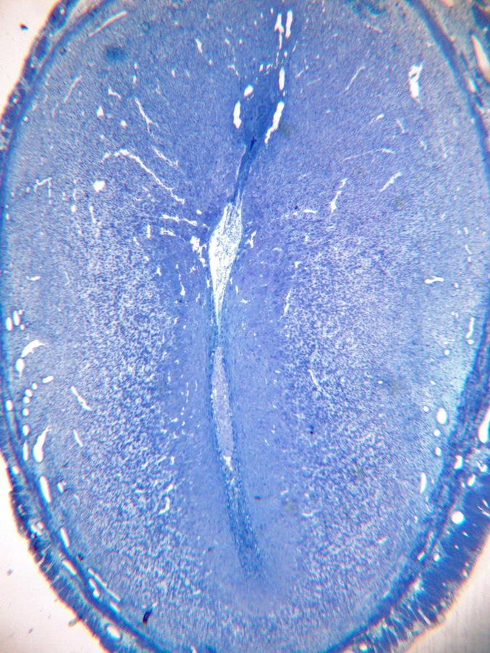
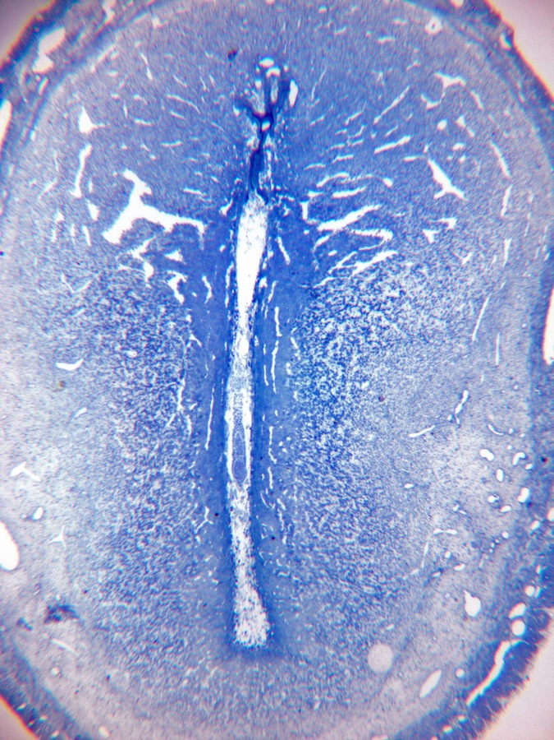
Evening of day 8. Note the large size of the mesometrial chamber, and the compact decidua.
Evening day 8.

Slide 29
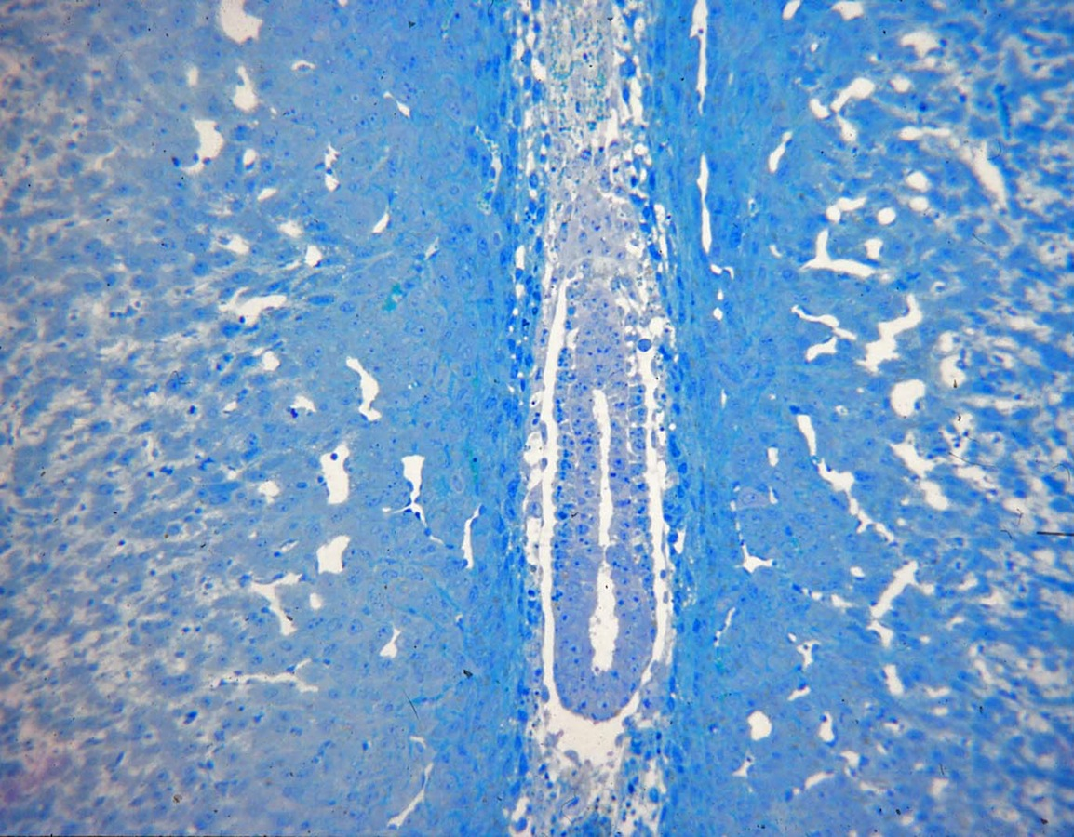
Proamniotic cavity has not yet been divided. Note how compact the decidua is on either side of the implantation site, as opposed to the elongated and irregular decidual cells immediately adjacent to trophoblast.

Slide 30
Components of the implantation site at the level of the ectoplacental cone - amniotic area junction.

Slide 31
At this mag variation in morphology of the decidual cells can be seen. Adjacent to the blastocyst and spaces with maternal blood, a few of the decidual cells are disintegrating. Next to these are elongated decidual cells, then compact decidual cells, many with lipid, surround maternal vessels. Toward the right the decidual cells are less compacted and have multiple fine processes adjacent to one another.
In the abembryonic extreme some of the giant trophoblast cells that phagocytize debris are at the top. Disintegrating decidual cells occupy much of the upper left.

Slide 32
In this micrograph trophoblast above is phagocytizing decidual cell debris. A maternal capillary has lost its integrity between the two arrows.

Slide 33
Note the way the maternal vessels converge towards the mesometrial chamber. Since the lymphocytes adhere to endothelial cells, they remain in maternal vessels when erythrocytes are flushed out.

Slide 34
A trophoblast giant cell is engulfing apoptotic decidual cells.

Slide 35
Implantation in the rat: Day 9
LGLs now become abundant in the mesometrial side of the decidua. The convergent vessels are broader and adherent lymphocytes are common in these flushed vessels.
Communication of the vessels in the decidua with the mesometrial chamber is shown by the flushing of blood cells from this chamber.

Slide 36
Note the convergence of maternal sinusoids towards the area above the conceptus.
Morning day 9
Although this site doesn’t show the mesometrial chamber because of the angle, it shows the proamniotic cavity and disintegrating decidua antimesometrially.

Slide 37
Area of the lumen above the ectoplacental cone shows disintegrating uterine epithelium. LGLs are in the adjacent decidua.
Morning day 9 implantation site

Slide 38
Afternoon day 9. The maternal blood cells have been flushed from the mesometrial cavity, indicating confluence with maternal vessels. Ectoplacental cone trophoblast now extends to the mesometrial chamber.
Disintegration of epithelium above the mesometrial chamber. Note again the abundance of LGLs, with prominent granules and pale cytoplasm.

Slide 39
The mesometrial vascular array is prominent. The proamniotic cavity has been divided into an ectoplacental cavity and amniotic cavity.
The antimesometrial decidua has almost completely disintegrated. Unlike the mesometrial cavity, maternal blood does not enter this area to any major extent.

Slide 40
Projection of the trophoblast ectoplacental cone into the mesometrial chamber.
Above the mesometrial chamber the uterine lumen has debris.

Slide 41
The ectoplacental cone projects above the ectoplacental cavity to the mesometrial cavity. The maternal blood cells in the meshwork of trophoblast on the lateral aspects of the cone have not been flushed, indicating a relative lack of circulation compared to the mesometrial chamber per se.
Openings of maternal blood vessels into the mesometrial chamber are seen.

Slide 42
A few mesenchymal cells are seen between the endoderm and ectoderm where the amniotic cavity is separated from the ectoplacental cavity.
Note the small size of parietal endoderm cells adjacent to the giant trophoblast cell in the middle right of the micrograph.

Slide 43
Evening day 9. Very little luminal epithelium appears anywhere within the site.
Diagram of site without the embryo.

Slide 44
Day 10
The embryo is enlarging rapidly, broadening the implantation chamber. Development of the exocelom now separates the proamniotic cavity into an ectoplacental cavity and an amniotic cavity.
An allantois projects into the exocelom, and the chorion forming the base of the ectoplacental cavity approaches the ectoplacental trophoblast.
LGLs in the mesometrial decidua are at their maximum.
Day 11
On the morning of day 11, the chorion fuses with the ectoplacental trophoblast.
By the afternoon fetal vessels vascularize the chorion, creating the beginning of chorioallantoic placental formation.

Slide 45
Implantation site on the afternoon of day 10.
Note the increase in breadth of the conceptus and surrounding area. The allantois on the right of the embryo is only partially sectioned.
Note the mesoderm under the head fold on the left, and the forming somites beneath the ‘inverted’ embryo.

Slide 46
Mesometrially the chorion forming the base of the ectoplacental cavity is approaching the ectoplacental trophoblast.
At the right the allantois projects into the exocelom above the amniotic cavity.

Slide 48
A meshwork of trophoblast giant cells encompass maternal blood in the ectoplacental cone.
The chorion consisting of ectoderm underlain by squamous mesothelial cells of the exocelom is approaching the cuboidal ectoplacental trophoblast cells.

Slide 49
Marginal region showing a maternal capillary lower right and numerous LGLs among the stellate decidual cells.
LGLs situated in dense decidua near the conceptus in the mesometrial decidua.

Slide 50
Maternal vessels within the mesometrial triangle showing trophoblast cells as part of the wall.
Two trophoblast giant cells encompassing maternal erythrocytes and cell debris abembryonically.

Slide 51
A longitudinal view showing the lumen of the uterus anterior and posterior to the implantation chamber, outside of the decidua. Day 11

Slide 52
Day 11. The chorion has fused with the ectoplacental trophoblast, eliminating the ectoplacental cavity. Although there are squamous mesothelial cells lining the exocelom, fetal vessels have not reached this region.

Slide 53
Afternoon day 11. There are now fetal vessels vascularizing the developing chorioallantoic placenta.

Slide 54
Mesometrial extent of the ectoplacental cone.
Note the maternal sinusoids converging on the mesometrial chamber and its ectoplacental trophoblast cells.

Slide 55
The first fetal vessels of the developing chorioallantoic placenta are seen below, at the margin of the exocelom.

Slide 56
On days 12-13, the major blood pathways of the placenta are established.

Slide 57
The placental artery enters the spongy zone {derived from the ectoplacental trophoblast} of the developing chorioallantoic placenta. Day 12.
The placental artery is seen near the developing chorioallantoic placenta in the mesometrial decidua.

Slide 58
Day 13 site, showing the yolk sac in addition to the developing chorioallantoic placenta and the placental artery.

Slide 59
In the lower right is the visceral yolk sac. Large maternal blood spaces are seen towards the chorionic plate. The labyrinth is beginning to be distinguished from the spongy zone adjacent to the overlying decidua.

Slide 60
From top to bottom: decidua, trophoblast giant cells, spongy zone, labyrinth, parietal yolk sac on Reichert’s membrane, visceral yolk sac.
Similar example showing fetal blood in the capillaries of the labyrinth. Most of the maternal blood from the labyrinth and spongy zone was removed by the perfusion fixation.

Slide 61
Higher mag of the spongy zone and overlying trophoblast giant cells.
The difference in size of fetal and maternal erythrocytes is seen in the spongy zone and labyrinth.

Slide 62
Delayed implantation
In lactating female rats nursing a sufficient number of kits, implantation is delayed and development of the blastocyst is slowed. Loss of the zona pellucida is delayed by approximately one day. The blastocyst is elongated but endoderm migration is delayed. The blastocyst, although situated abembryonicly in a uterus with an undulating lumen, is not oriented.
A blastocyst on day 6 of delayed implantation. Note that the zona pellucida has been lost but that there is no migration of endodermal cells abembryonically.

Slide 63
Scanning micrograph of the rat uterus cut on the mesometrial side and folded open, showing the blastocyst situated antimesometrially. Note that the endometrium is folded at this stage.
The reciprocal side of the uterus shown above. An image made by the presence of the blastocyst is seen towards the top of the third fold from the left. This is antimesometrial.

Slide 64
A delay blastocyst lying longitudinally along the luminal epithelium. The epithelium, underlying stroma, and the side of the blastocyst have been split open.
Inner cell mass end of the blastocyst, showing the large flattened trophoblast cells that overlie the ICM. Note that there are pinopods on the surface of the endometrium to the left of the blastocyst.

Slide 65
Enders AC, Schlafke S. A morphological analysis of the early implantation stages in the rat. Am J Anat 1967;120:1-42.
Enders AC, Schlafke S. Cytological aspects of trophoblast-uterine interaction in early implantation. Am J Anat 1969;125:1-30.
Enders AC, Nelson DM. Pinocytotic activity by the uterus of the rat. Am J Anat 1973;138:277-300.
Enders AC. The implantation chamber, blastocyst and blastocyst imprint of the rat: a scanning electron microscope study. Anat Rec 1975;182:137-150.
Enders AC, Given RL, Schlafke S. Differentiation and migration of endoderm in the rat and mouse at implantation. Anat Rec 1978;190:65-78.
Enders AC, Schlafke S, Welsh AO. Trophoblast and uterine luminal epithelial surfaces at the time of blastocyst adhesion in the rat. Am J Anat 1980;159:59-72.
Welsh AO, Enders AC. Occlusion and reformation of the rat uterine lumen during pregnancy. Am J Anat 1983;167:463-477.
Welsh AO, Enders AC. Light and electron microscopic examination of the mature decidual cells of the rat, with emphasis on the antimesometrial decidua and its degeneration. Am J Anat 1985;172:1-30.
Schlafke S, Welsh AO, Enders AC. Penetration of the basal lamina of the uterine luminal epithelium during implantation in the rat. Anat Rec 1985;212:47-56.

Slide 66
Welsh AO, Enders AC. Trophoblast-decidual cell interactions and establishment of maternal blood circulation in the parietal yolk sac placenta of the rat. Anat Rec 1987;217:203-219.
Welsh AO, Enders AC. Chorioallantoic placenta formation in the rat: I. Luminal epithelial cell death and extracellular matrix modifications in the mesometrial region of implantation chambers. Am J Anat 1991;192:215-231.
Welsh AO, Enders AC. Chorioallantoic placenta formation in the rat. II. Angiogenesis and maternal blood circulation in the mesometrial region of the implantation chamber prior to placenta formation. Am J Anat 1991;192:347-365.
Enders AC, Welsh AO. Structural interactions of trophoblast and uterus during hemochorial placenta formation. J Exp Zool 1993;266:578-587.
Welsh, AO, Enders AC. Chorioallantoic placenta formation in the rat. III. Granulated cells invade the uterine luminal epithelium at the time of epithelial cell death. Biol Reprod 1993;49:38-57.
Welsh AO. Uterine cell death during implantation and early placentation. Microsc Res Tech 1993;25:223-245.

