Slide 1
Implantation in the macaque:
from adhesion of the blastocyst to the lacunar stage
Allen C Enders
Department of Cell Biology and Human Anatomy
University of California, Davis
This collection of micrographs is representative of material obtained with numerous co-authors during three decades of study of implantation in the macaque. More complete descriptions appear in the papers in the bibliography. However, this presentation presents color micrographs in particular and in chronological sequence so that interested investigators glancing through them can receive an impression of the morphological changes occurring during the first and least readily obtained stages of implantation in the macaque.

Slide 2
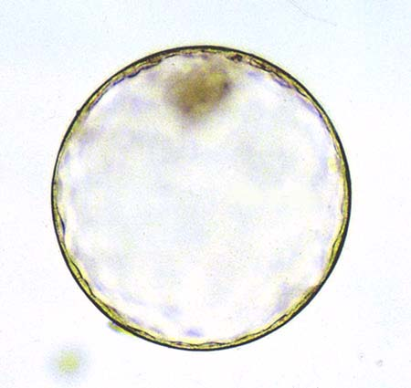
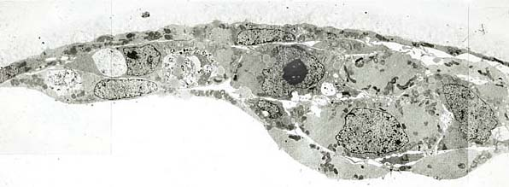
Peri-implantation blastocyst (day 7-8)
Section through the inner cell mass of a blastocyst (day 7).
It is still within a zona pellucida, and endoderm cells have differentiated beneath the inner cell mass (ICM).
Intact blastocyst within its zona pellucida (day 7).
Section through the ICM of a blastocyst on day 8.
Blastocysts at this age have lost the zona pellucida. The endodermal cells are well differentiated, and there are irregular projections from the trophoblast overlying the ICM.
Electron micrograph of the above blastocyst.
The blastomeres of both the ICM and the endodermal cells still have areas that are relatively free of organelles, as in earlier stages.

Slide 3
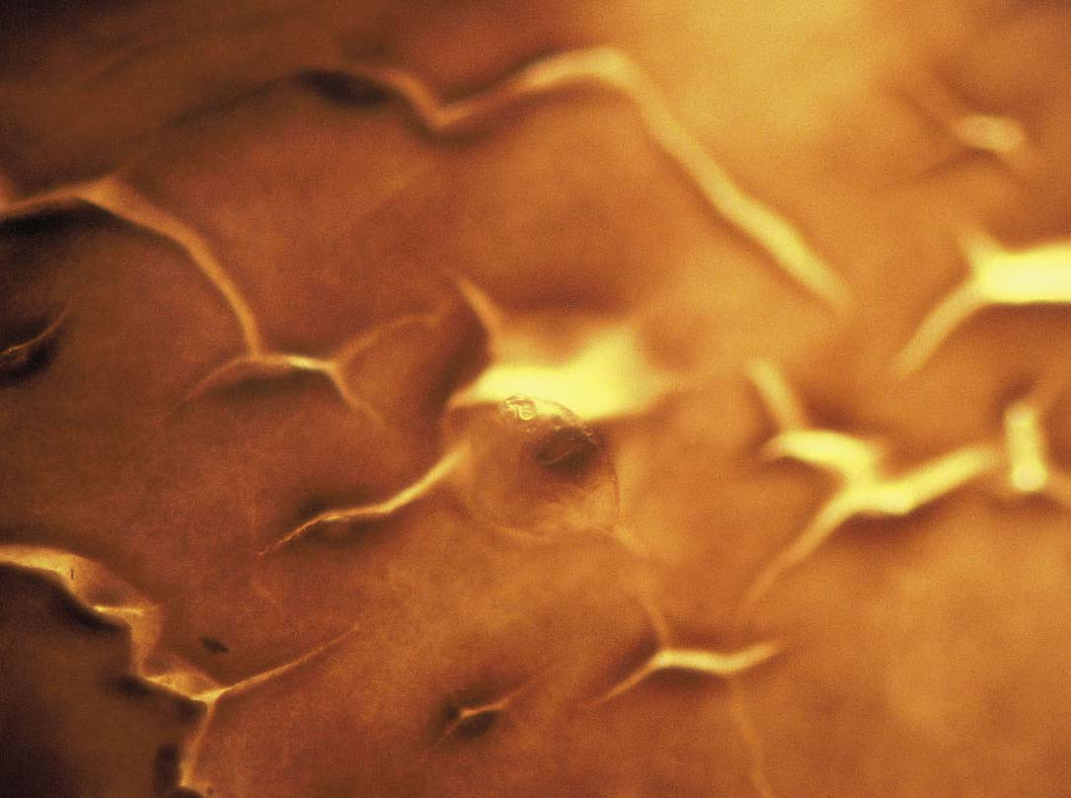
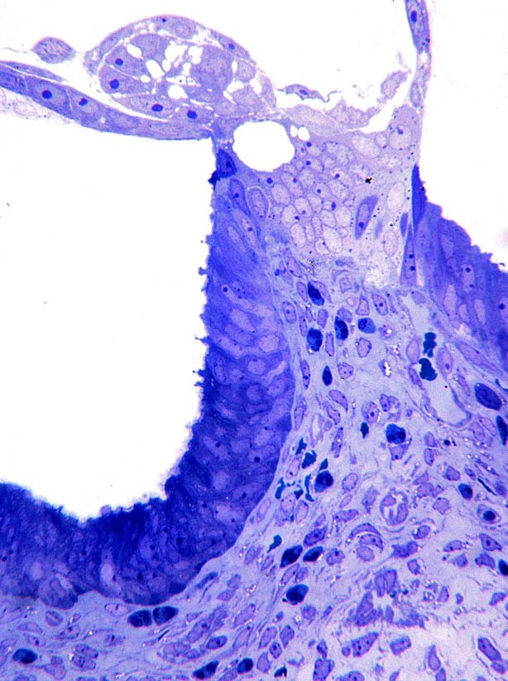
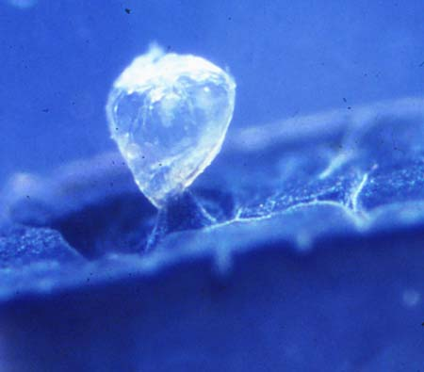
The first day of implantation (day 9)
Surface view of an implantation site on day 9.5.
The blastocyst was not visible until the surrounding uterus began to darken during postfixation with osmium.
Lateral view.
The blastocyst had been pulled up from a depression.
Section of the same site.
Syncytial trophoblast extends into the layer of columnar cells lining the uterine lumen. It only extends to the basement membrane. Note the radial arrangement of the inner cell mass cells.

Slide 4
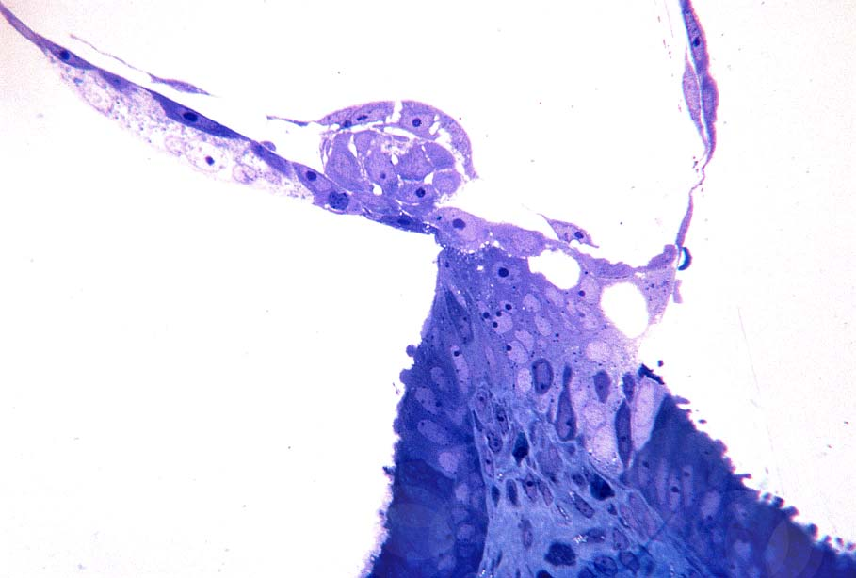
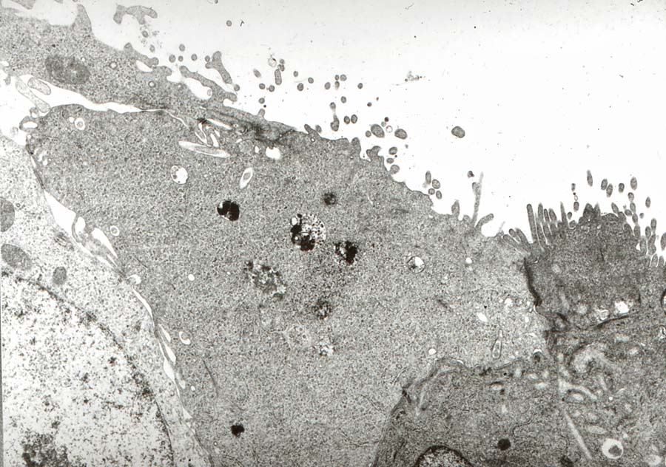
Another area of this implantation site.
Syncytial trophoblast is surrounding luminal epithelial cells and extending to the basement membrane of the luminal epithelium. Note the unattached mass of syncytial trophoblast to the left of the inner cell mass.
Trophoblast in the center is sharing a junctional complex with the uterine epithelial cell (dark). Note that the trophoblast also sends projections into the uterine cell.

Slide 5
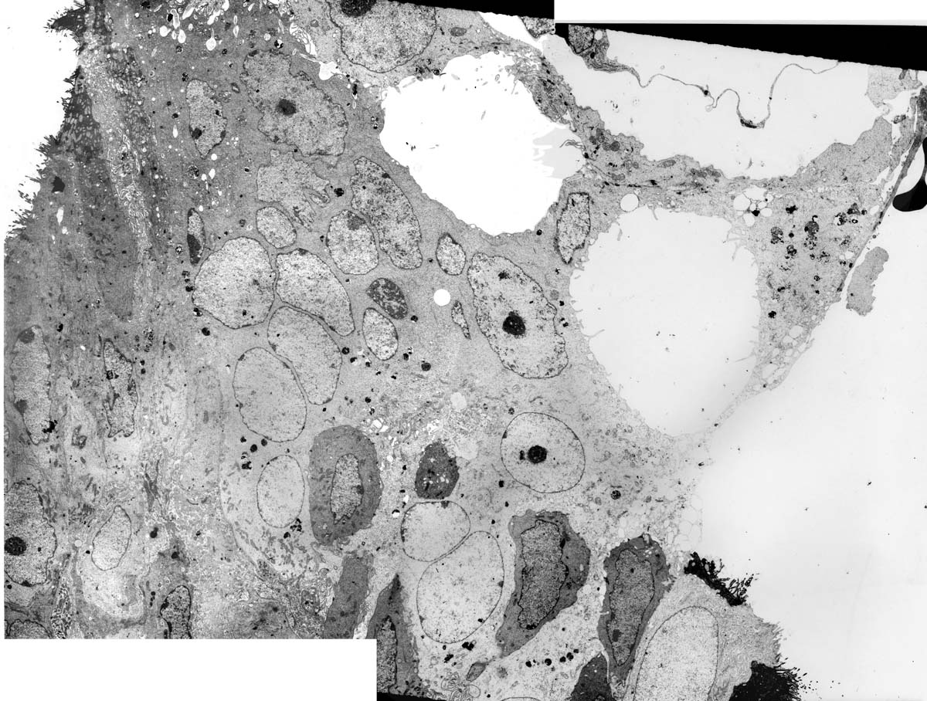
Montage of electron micrographs of the day 9.5 site in previous slide.
The syncytial trophoblast extends to the uterine luminal basal lamina on the left, and is surrounding several uterine cells (dark). The trophoblast adheres to uterine cells on either side of the area of penetration.

Slide 6
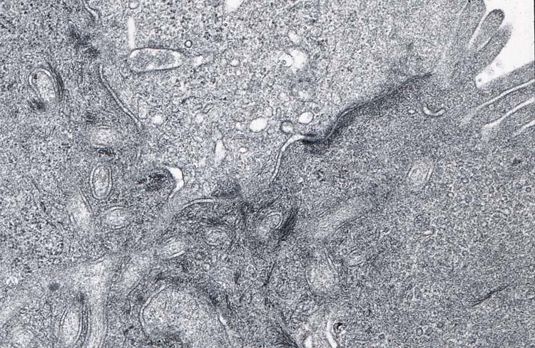
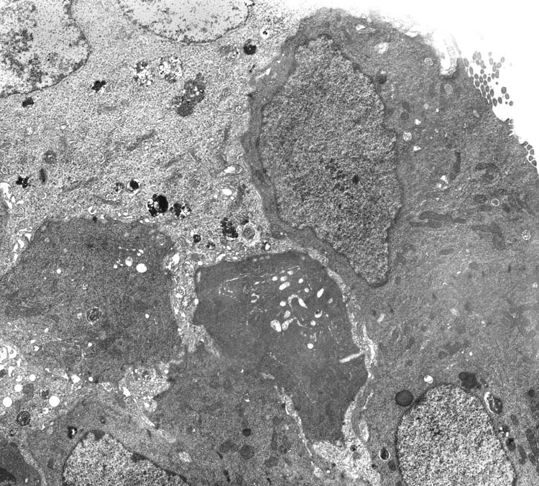
Pale trophoblast is sharing a junction with two uterine epithelial cells, and extending processes into the cells. Note the uniform microvilli on the uterine cell to the right.
Tangential section of intruding trophoblast.
Processes of pale syncytial trophoblast cytoplasm have infiltrated around dark uterine luminal epithelial cells. A uterine cell in the upper right is ciliated.

Slide 7
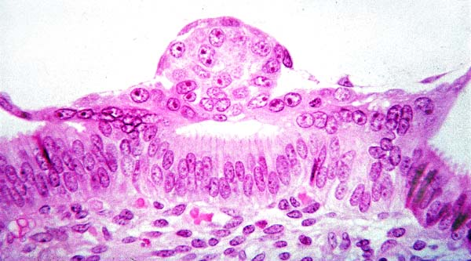
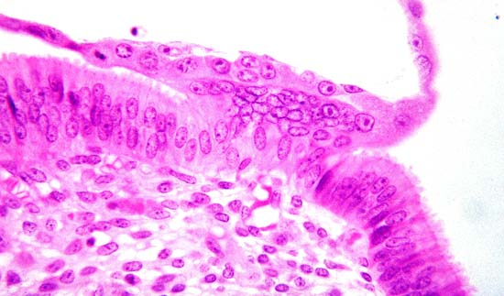
Macaque implantation site from the Carnegie collection.
Two areas of syncytial trophoblast are extending into the uterine luminal epithelium on either side of the inner cell mass.
The nuclei are clustered within the syncytial trophoblast that penetrates into the uterine epithelium.

Slide 8
Interpretation of the first penetration stage, day 9:
Syncytial trophoblast initiates implantation by insinuating between healthy uterine luminal epithelial cells. Trophoblast processes intrude between epithelial cells, adhering to any adhesion junctions present on those cells. Sharing the junctions both maintains the integrity of the epithelium and anchors the trophoblast.
By penetrating between uterine cells, the trophoblast is directed towards the basal lamina of the epithelial cells.
Initially the uterine cells, although distorted, appear little damaged and serve both to anchor the trophoblast and to direct it towards the residual uterine luminal basal lamina.
More than one syncytial mass from the para-ICM region may be involved in this process.
The endometrium has undergone neither a decidual response nor an epithelial plaque response at this stage of implantation.
Formation of the embryo:
The inner cell mass at this stage is a slightly flattened sphere. Offset slightly towards the trophoblast, a series of apical junctional complexes demonstrate the polarity of the cells and indicate where an amniotic cavity will form subsequently. The basal lamina underlying the ICM cells is continuous with the basal lamina underlying the parietal trophoblast. There is no basal lamina separating the ICM cells from polar trophoblast of the invasion site.

Slide 9
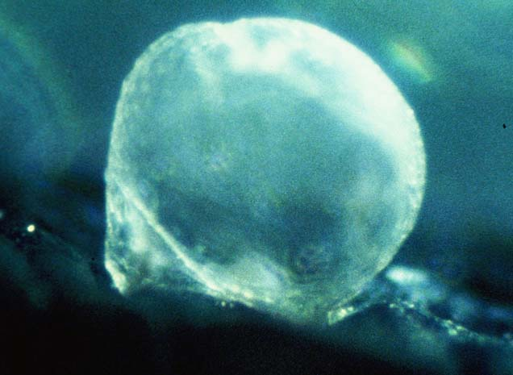
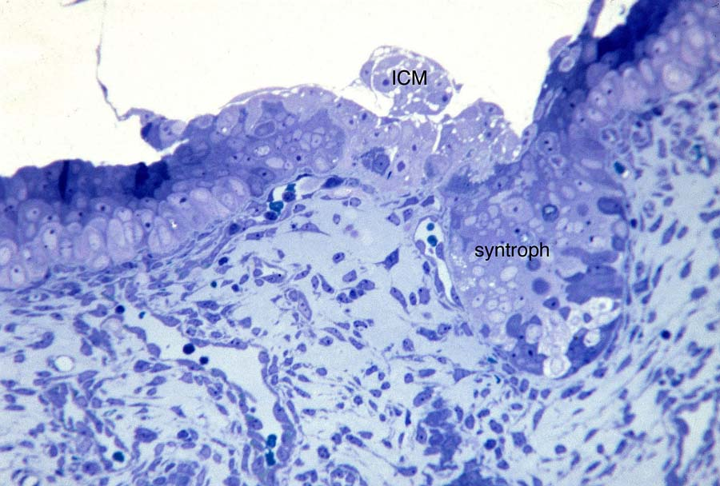
The second day of implantation, trophoblastic plate stage (day 10)
Blastocyst on day 10.
The area by the ICM is attached to the uterine epithelium.
Section of this blastocyst.
While the trophoblast still has not penetrated beyond the basal lamina of the uterine luminal epithelium, trophoblast extends into the gland on the right. This trophoblastic plate stage shows both cytotrophoblast and syncytial trophoblast, with a tendency for the syncytial trophoblast to be more abundant at the margin of the site. Note that there is a pronounced epithelial plaque reaction, with enlarge luminal epithelial cells forming a basal layer under unmodified uterine cells.

Slide 10
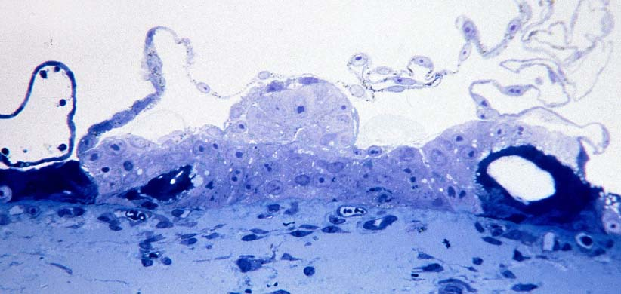
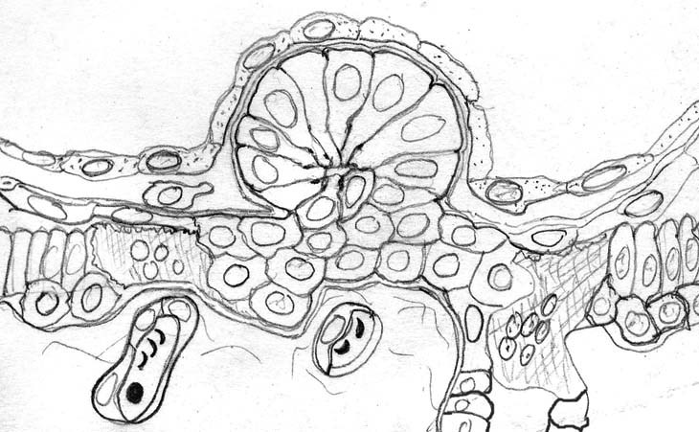
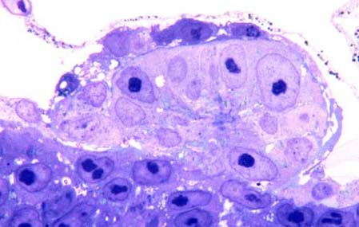
The inner cell mass, which still lacks an amniotic cavity, rests largely on cytotrophoblast which in turn is in contact with the residual basement membrane of the uterine luminal epithelium. There is syncytial trophoblast at the margins. A vesicle of uterine epithelial cells is at the left.
Drawing of trophoblastic plate stage.
The trophoblastic plate underlying the ICM is composed of a mixture of cytotrophoblast cells and syncytial masses. Syncytial masses are present at the periphery of the site, and appear to invade endometrial glands when they are encountered.
Higher magnification of this day 10 site. Note that in the center of the ICM there is a region of junctional complexes (arrow) where the amniotic cavity will develop.

Slide 11
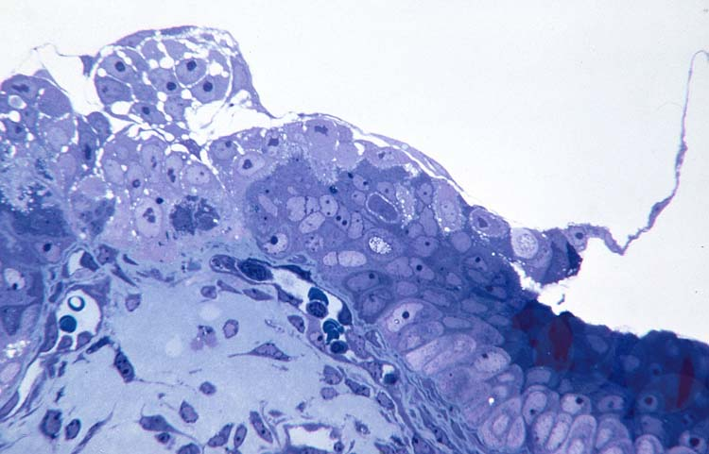
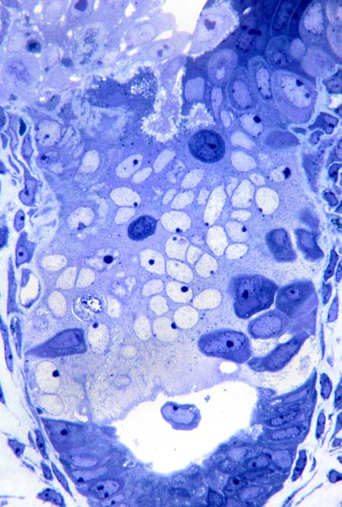
A different section of the same site. Note that the syncytial trophoblast on the right has not intruded into the underlying capillary, but is closely applied to the uterine plaque cells on the far right. Both cellular and syncytial trophoblast are seen directly under the inner cell mass.
The gland seen in the first d10 site section shown.
Note that many of the uterine epithelial cells in the midregion of the gland have been surrounded by the intruding trophoblast. In the upper left (arrow) is an irregular branching pale area; this region in electron micrographs shows clefts lined by microvilli.

Slide 12
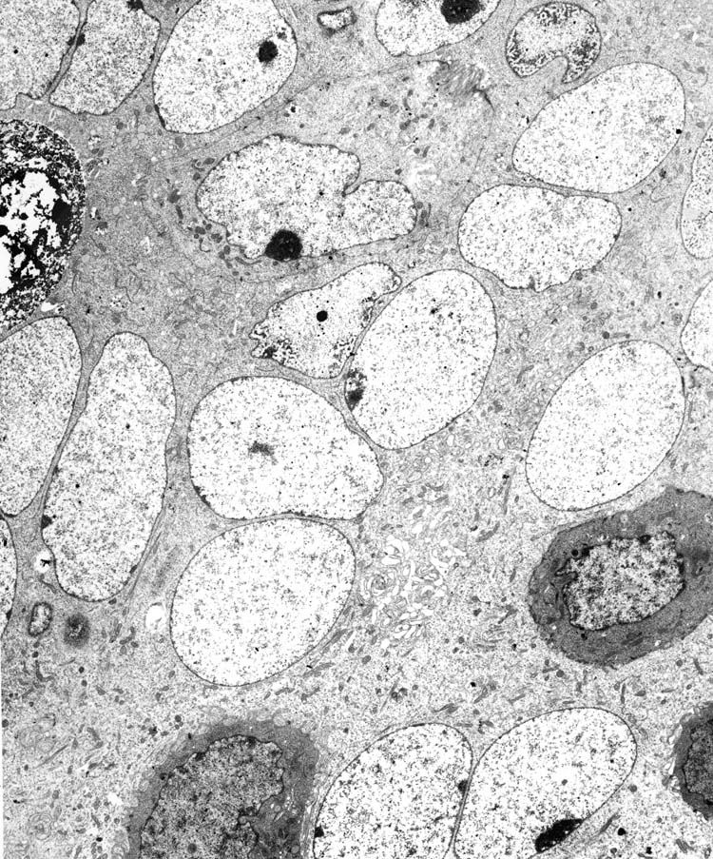
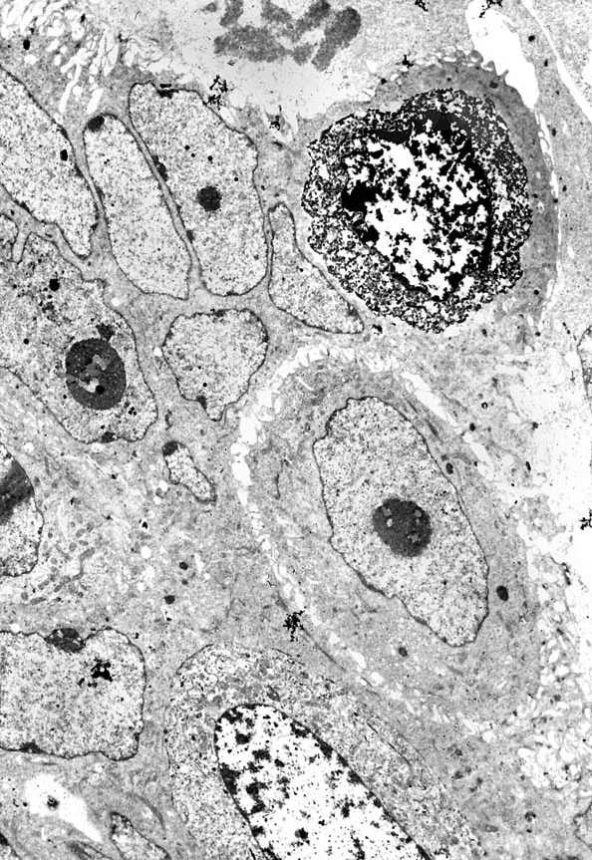
Electron micrograph of trophoblastic plate cells.
The syncytial trophoblast surrounds a degenerating cell on the right; adjacent to this is a dividing cytotrophoblast cell.
Electron micrograph of surrounded epithelial cells.
Two of the dark epithelial cells appear healthy, but the cell in the upper left appears to be becoming necrotic.

Slide 13
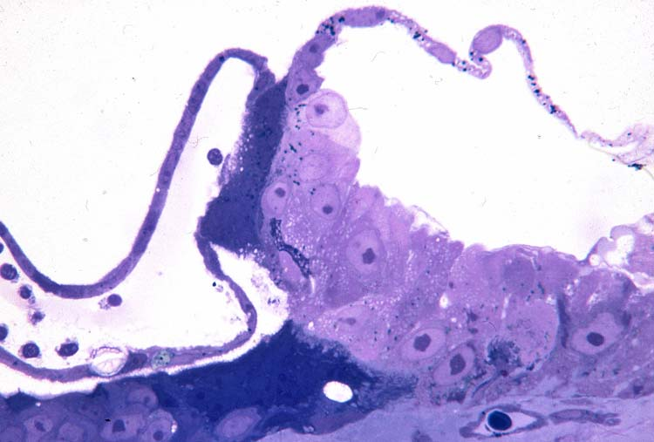
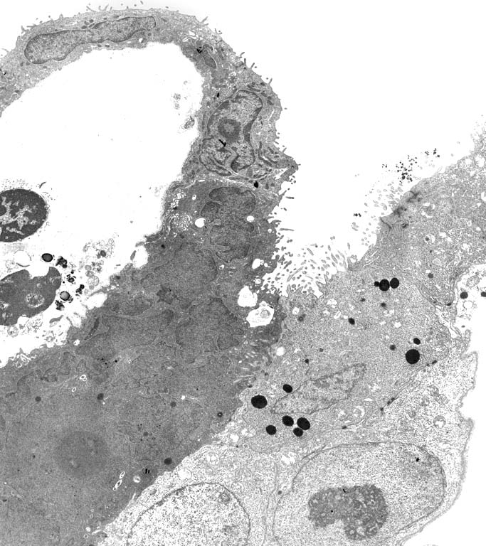
Margin of a trophoblastic plate stage.
The dark syncytial trophoblast has invaded a vesicle formed of uterine epithelial cells as well as the uterine luminal epithelium below.
Electronmicrograph of this site. The dark syncytial trophoblast intrudes into the wall of the uterine vesicle on the left, as well as sharing junctions with the rest of the trophoblast on the right.

Slide 14
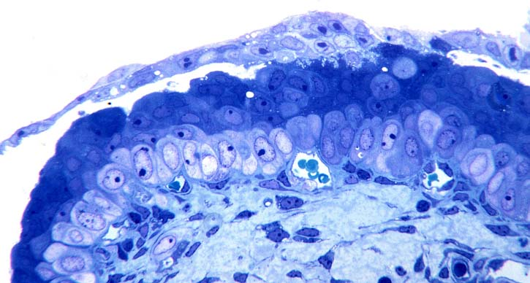
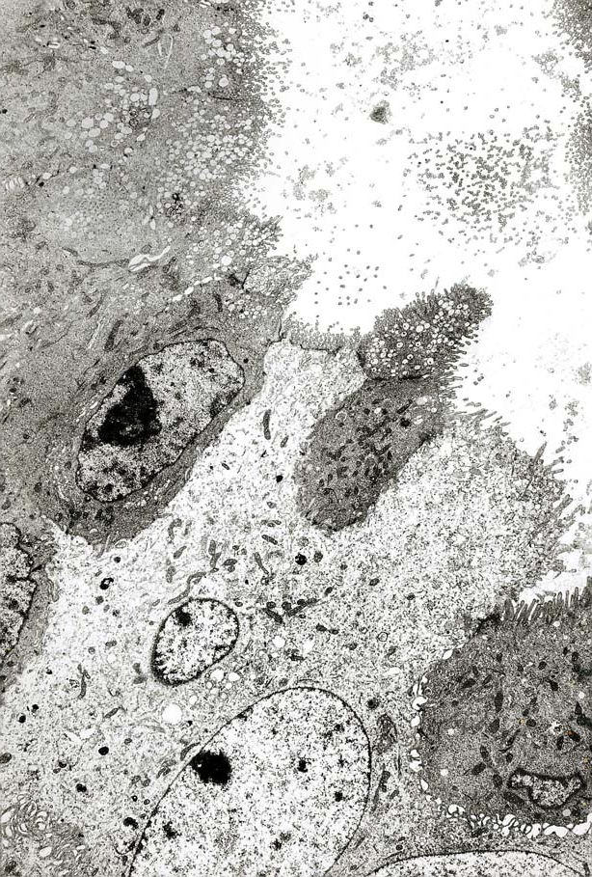
Extreme margin of a day 10 trophoblastic plate.
Trophoblast is intruding into the uterine luminal epithelium above pale plaque cells.
Electron micrograph of the margin of a site.
The syncytial trophoblast (pale) adheres to uterine epithelial cells, including the edges of two epithelial cells that it surrounds.

Slide 15
Interpretation of the trophoblastic plate stage:
As the implantation site expands during the trophoblastic plate stage, an epithelial plaque response is occurring in the uterine epithelium. The cytotrophoblast increases in abundance so that both syncytial and cytotrophoblast are present within the trophoblastic plate. The trophoblast still does not extend beyond the residual basal lamina, but any uterine epithelial cells that have been surrounded disappear. Possibly they degenerate as suggested by the presence of degenerating cells within the syncytial trophoblast as seen in two of the EMs.
The expansion of the site laterally occurs by intrusion but into an epithelium that is different from that seen in the initial invasion. The penetration of trophoblast into a vesicle formed of uterine epithelial cells suggests that there can be considerable variation in the epithelium, and trophoblast can still attach to and penetrate it (as does in vitro attachment and penetration of non uterine epithelia by macaque blastocysts). It also suggests that both the blastocyst and the uterine vesicle may have been moved to their position in the uterine lumen by the same factors, presumably uterine muscle contraction, and were held there by uterine luminal closure.

Slide 16
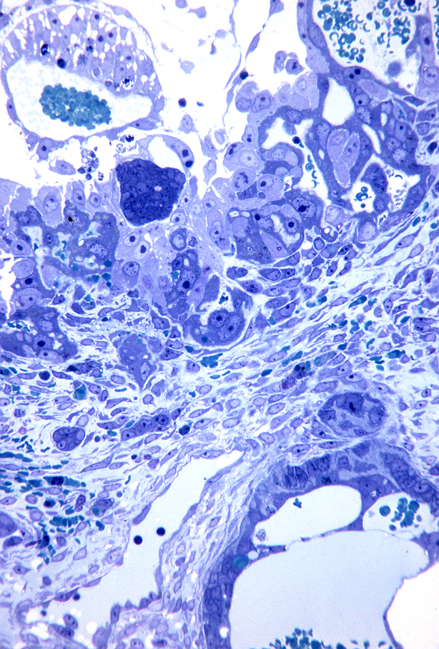
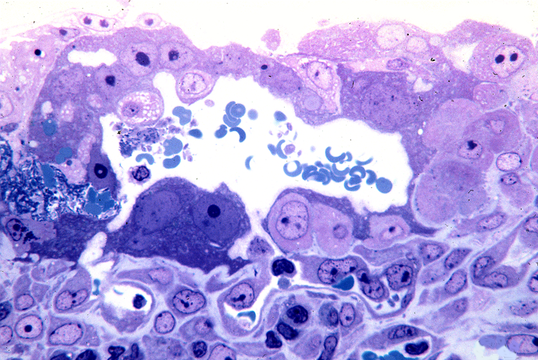
Early lacunar stage, day 11:
Continuity of a lacuna with an endometrial capillary in the underlying stroma.
Note the small cleft (arrow) joining the two.
In this early lacunar stage, blood has leaked into the amniotic cavity beneath the epiblast.
However, the cytotrophoblast and syncytial trophoblast lining lacunae appear healthy. Note the distinct border between trophoblast and underlying endometrial stroma and the invaded gland in the lower right

Slide 17
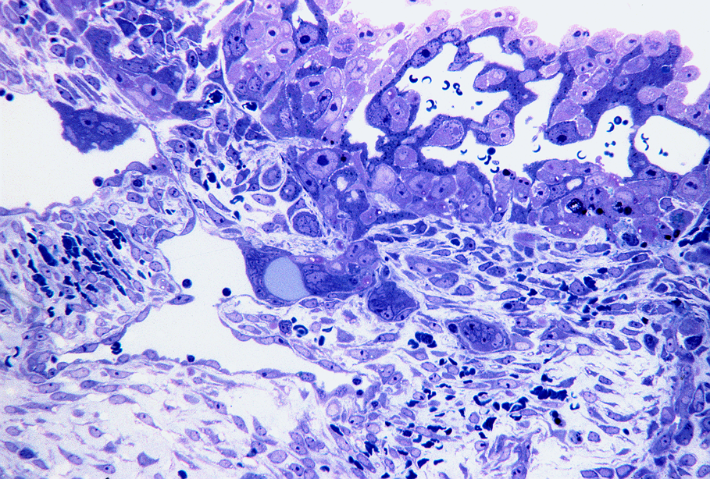
Syncytial trophoblast joining capillaries.
Trophoblast masses (arrows) have entered the dilated endometrial capillaries beneath this lacunar stage site.

Slide 18
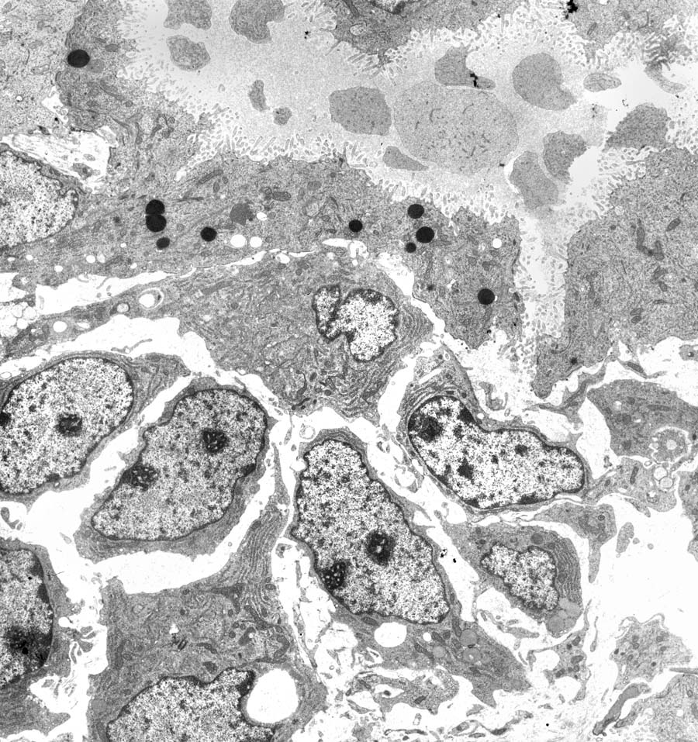
A slightly disrupted maternal capillary at the top of the micrograph. Below are endometrial stromal cells, two of which are beginning to decidualize.

Slide 19
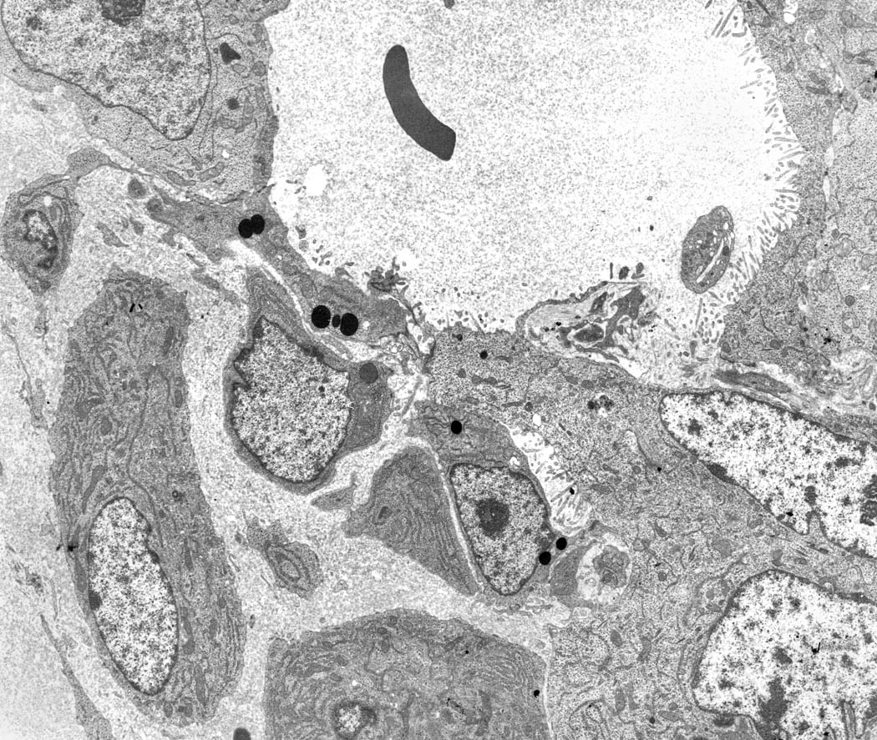
A lacuna with a small segment of an endothelial cell (with dark lipid cells).

Slide 20
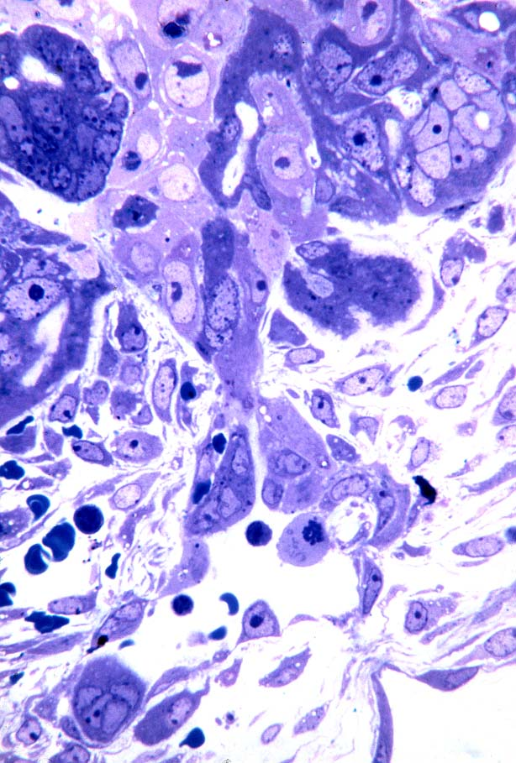
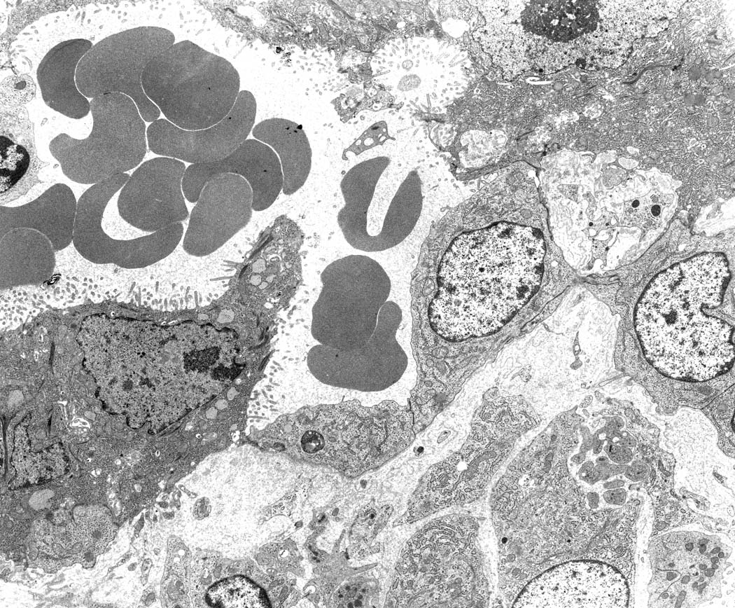
Trophoblast-endothelial cell abutment.
The syncytial trophoblast lining a lacuna completes the wall of a superficial capillary by sharing junctions with the endothelial cells. Note the numerous microvilli on the syncytiotrophoblast on either side of the endothelial cells.
Note the clefts in the dark syncytial trophoblast (arrows), and the continuity of trophoblast from the site with that entering the dilated vessel below.

Slide 21
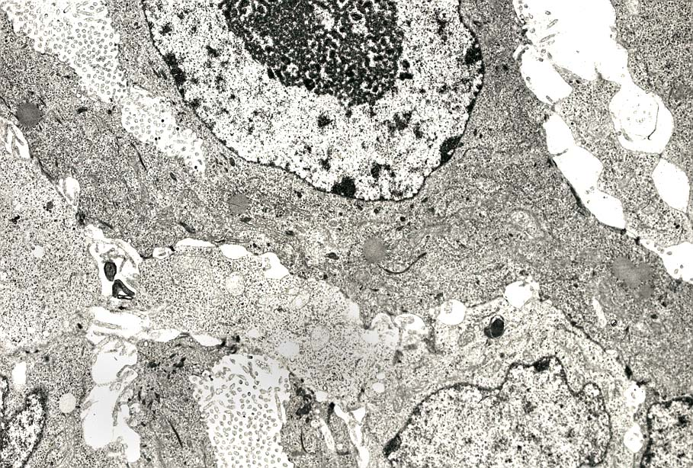
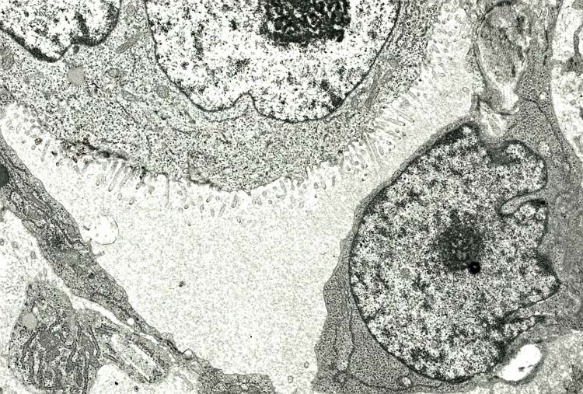
Cytotrophoblast and syncytial trophoblast within a site.
Microvilli from the syncytial trophoblast are abundant within the clefts.
A syncytial trophoblast mass intrudes into the lumen of a capillary below.

Slide 22
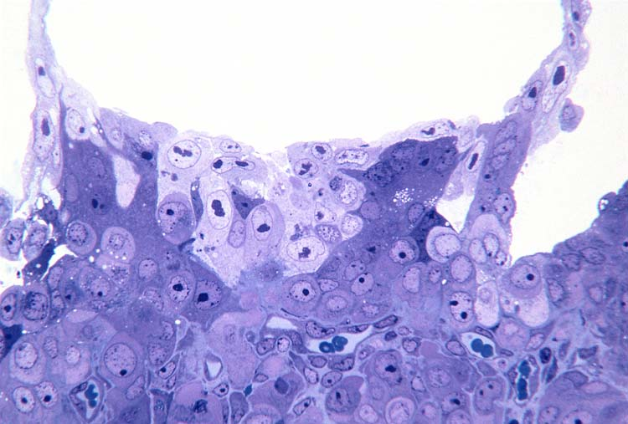
A day 11 secondary implantation site (abembryonic).
Pale cytotrophoblast cells and dark syncytial trophoblast are closely applied to epithelial plaque cells. Although a capillary is seen in the middle, no lacunae have formed at this stage.

Slide 23
Summary and interpretation of the early lacunar stage (Day 11)
During this stage, clumps of syncytial trophoblast intrude into the underlying expanded endometrial capillaries. They form part of the wall of these structures rather than occluding them. Clefts within the syncytial trophoblast become more numerous, and some of them expand into lacunae partially filled with maternal blood. It appears that it is syncytial trophoblast at this stage that most readily penetrates through the residual basal lamina of the uterine luminal epithelium and into the underlying capillaries. This usually occurs under the central part of the implantation site, where there is little or no plaque reaction, but as the site expands laterally it necessarily encounters plaque. The syncytium lining the lacunae is relatively thin, with well-spaced nuclei and microvilli on the surface towards the maternal blood space. The thinness of the layer, the microvilli, and the well-spaced nuclei contrast with syncytial trophoblast with clustered nuclei and fewer more irregular microvilli that penetrates into the superficial vessels.
Formation of the embryo: By day 11 a distinct amniotic cavity can be found overlying epiblast cells. The basal lamina under the epiblast is continuous around the amniotic epithelium and onto the trophoblast. An occasional isolated cell appears between the parietal yolk sac, especially adjacent to the ICM, and the trophoblast. These cells generally share cytological characteristics with the overlying endodermal cells, suggesting derivation from endoderm. There is still no well-formed basal lamina under the endoderm but there is a basal lamina underlying trophoblast and therefore between trophoblast and the cells situated between endoderm and trophoblast.

Slide 24
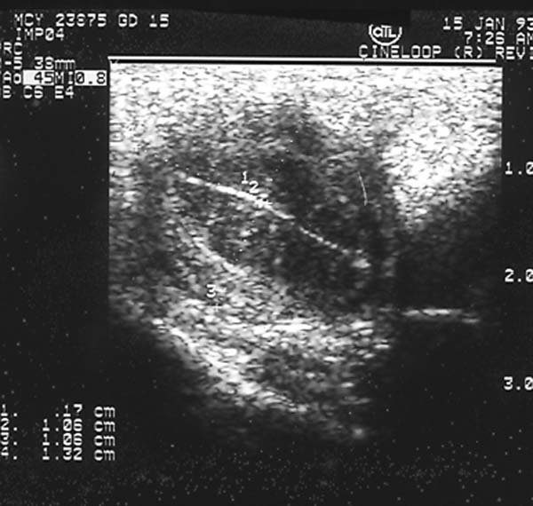
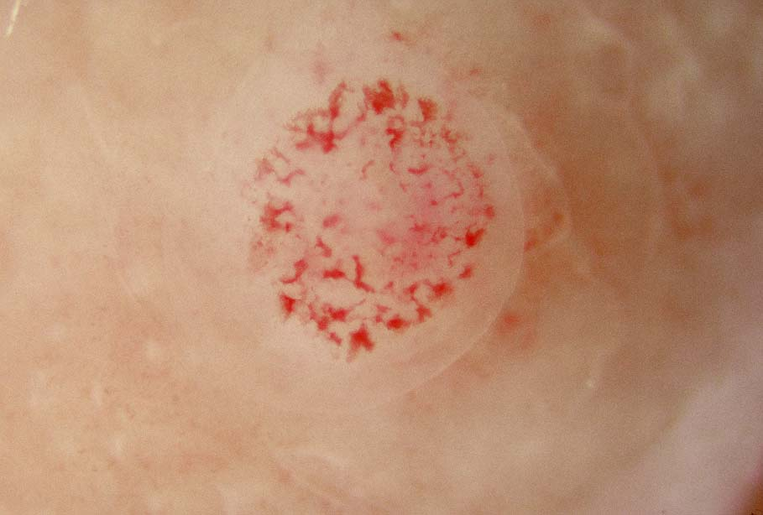
Lacunar stage of implantation (day 12-13)
Ultrasonogram of a uterus on day 12.
The implantation site shows as a small blip in the otherwise closed uterine lumen.
Surface view of a day 12 implantation site.
The blood in the lacunae shows clearly. A pale region of edema surrounds the area of implantation.

Slide 25
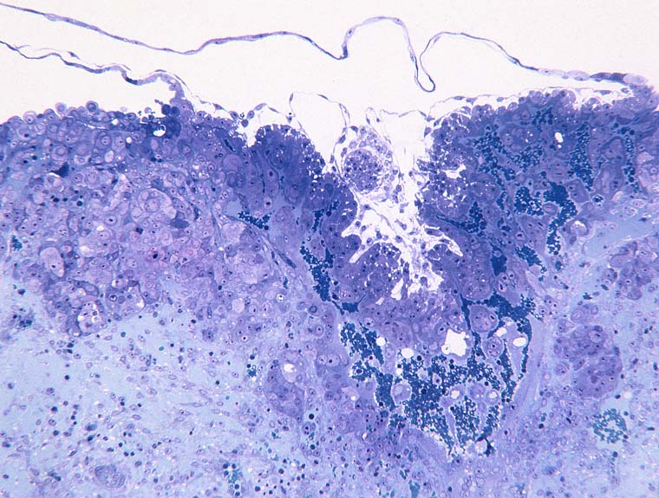
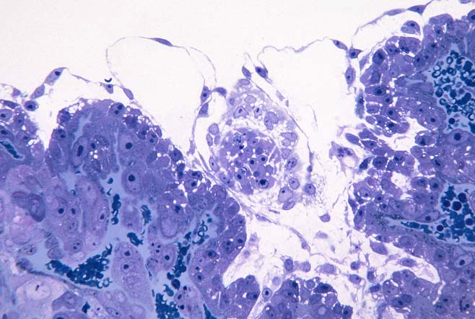
Higher magnification of the site in micrograph on the left.
Note that the vessel in the lower left opens into lacunae. The embryo is seen slightly tangentially. Constriction of the primary yolk sac (arrows) to form the small secondary yolk sac is nearly completed.
Overview section of a day 12 site.
The lacunae contain blood but have not expanded. This site penetrates into the endometrium, and is surrounded by substantial plaque at its periphery.

Slide 26
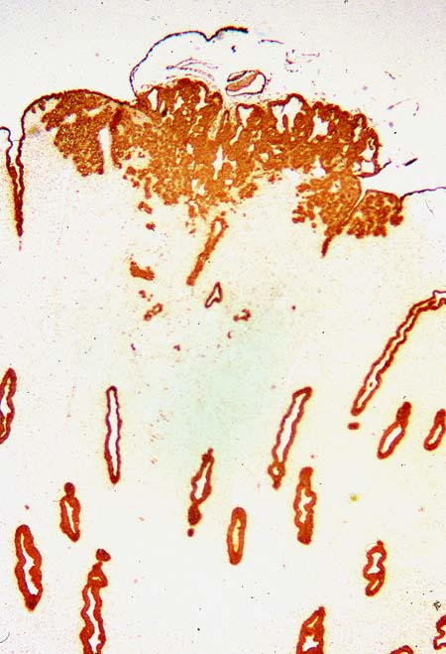
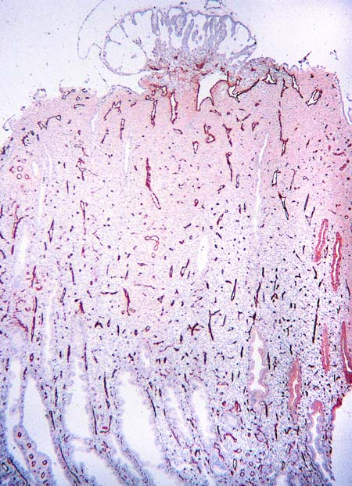
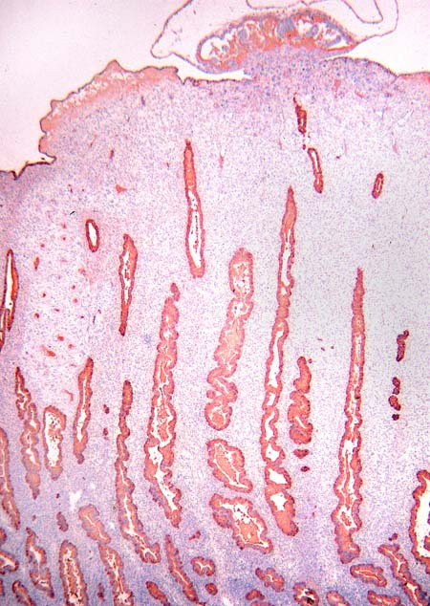
Cytokeratin immunostaining of a day 12 site.
The embryo, trophoblast, plaque cells and gland cells are stained. Cytotrophoblast cells have invaded into an endometrial artery (arrows).
An extremely superficial day 12 site.
The endothelial of the endometrial blood vessels has been immunostained for factor VIII.
The same day 12 site immunostained for glycodelin (PP14).
The distribution of endometrial glands is shown.

Slide 27
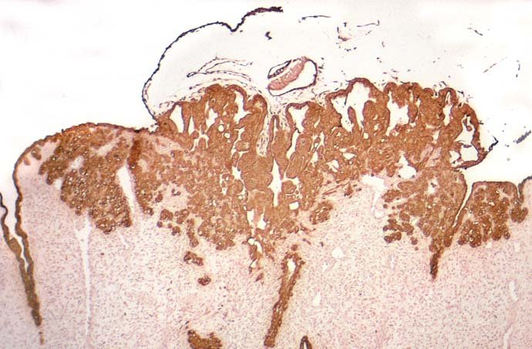
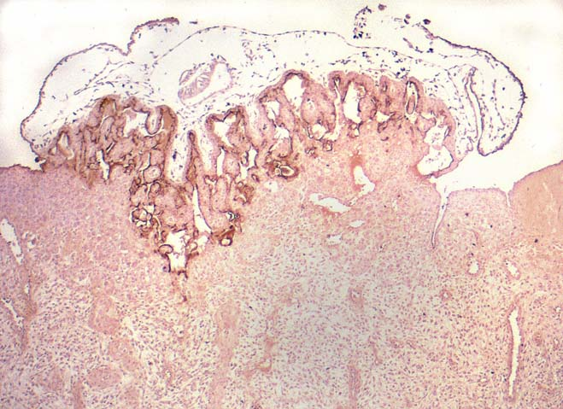
An enlargment of a section shown on the previous slide
Cytokeratin immunostains all epithelial elements.
Same site immunostained for SP1.
Pregnancy specific beta-1 immunoglobulin demonstrates the distribution of syncytial trophoblast, and consequently outlines the lacunar aspect of the implantation site.

Slide 28
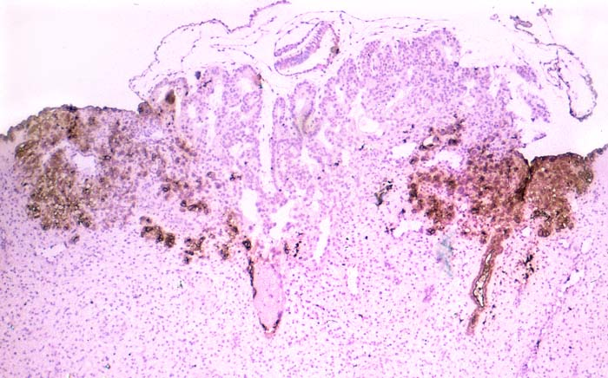
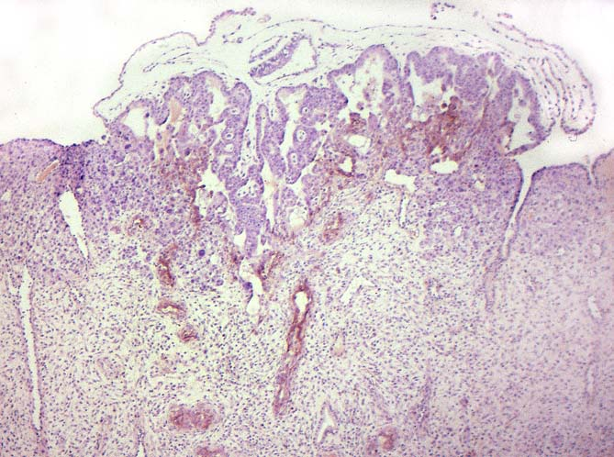
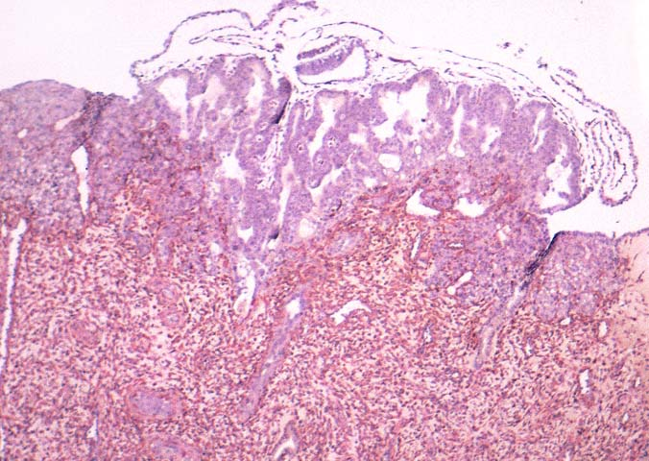
Same site stained with the lectin DBA.
This lectin shows the distribution of the plaque cells.
Site immunostained for NCAM.
This antibody labels the surface of the invasive cytotrophoblast cells. Note that these cells are at the front of the implantation site and extend into the arterioles in the underlying endometrium (arrows).
Site immunostained with vimentin antibody.
This antibody shows the distribution of endometrial fibroblasts

Slide 29
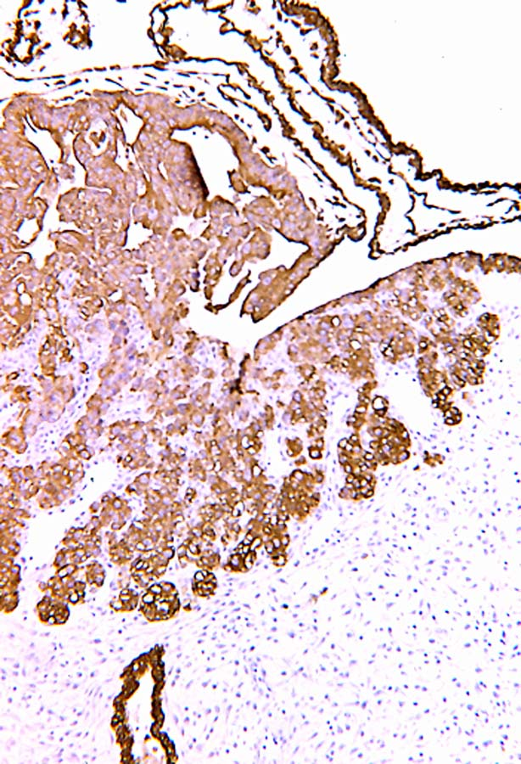
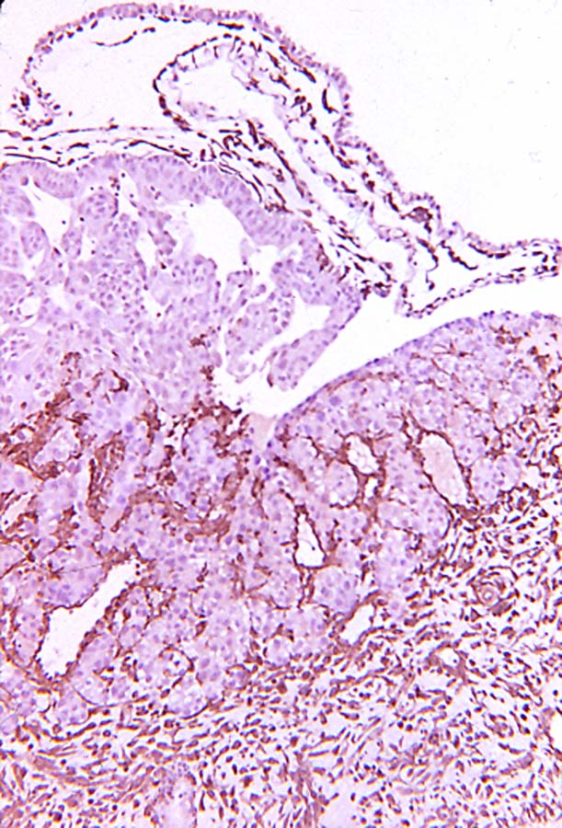
Margin of a site immunostained for cytokeratin. In addition to trophoblast and plaque cells, fetal mesenchymal cells which are derived from the primary endoderm of the yolk sac are also stained.
Adjacent section immunostained for vimentin.
Note the fibroblasts and endothelial cells between strands of plaque cells, and the staining of mesenchymal cells lining the trophoblast.

Slide 30
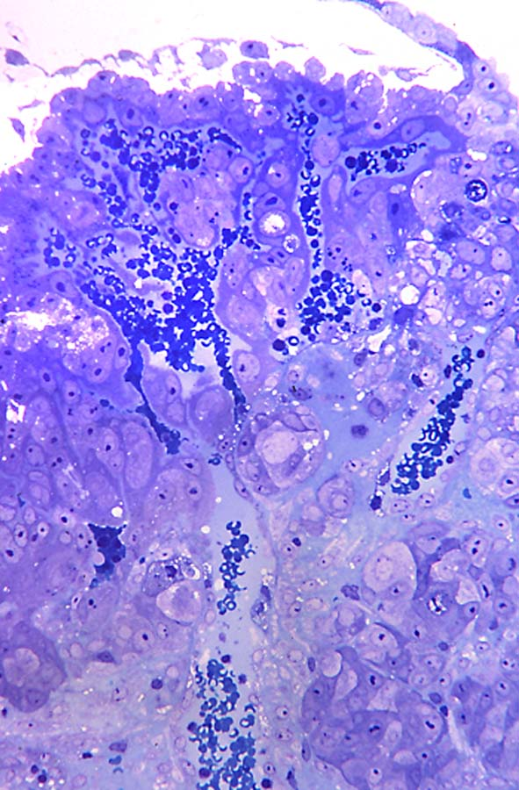
Continuity of the dilated superficial vessels with the lacunae, day 12.
Higher magnification of vessel continuity with the lacuna. Syncytial masses partially restrict the region of confluence.

Slide 31
View of intact day 12 implantation site.
The lacunar region is a faint pink region. The inner cell mass is in the center, and a thickening of the abembryonic trophoblast is apparent.
Sectioned block of the site .
The embryo and amnion are clearly visible, as is the thickened abembryonic trophoblast.
Semithin section from the same site.
This section does not include the embryo.

Slide 32
Lacunar region of day 12 site.
The junctional region is occupied by syncytial trophoblast, except at the broadly open lacuna to the left center, and a small area right of center where cytotrophoblast abuts endometrium (arrow).
Syncytial trophoblast on the right and left forms part of the margin of the lacuna. An endothelial cell (dark) is partially displaced, and pale cytotrophoblast cells are present as a portion of the lacunar wall. Trophoblast junctions with endothelial cells maintain much of the integrity of the superficial endometrial vessels .

Slide 33
A cut across the uterus on day 13.
The blood-filled lacunae of this implantation site are clearly visible. Although the abembryonic trophoblast above proved to be attached to the uterus, it did not have sufficient blood filled lacunae at this stage to appear similar to the lacunae of the primary implantation site.
Section through a site on day 13.
Note that fetal mesenchymal cells are beginning to indent the cytotrophoblast overlying the lacunae, indicting incipient secondary villus formation.

Slide 34
Abembryonic trophoblast, day 12 The syncytial trophoblast probably pulled free of the uterine epithelium.
Margin of the same day 13 secondary site. Note that some of the large plaque cells have regions of glycogen (pink).
A secondary implantation site on day 13. Note that there is a lacuna with a few erythrocytes at the right. This secondary site has aspects of both the trophoblastic plate stage and the lacunar stage.

Slide 35
Summary and interpretation of the lacunar stage of implantation (day 12-13)
During day 12 and 13, the lacunar stage becomes fully developed with syncytial trophoblast lining the lacunae. The secondary yolk sac is formed, and the remaining primary yolk sac becomes the lining of the exocelom. The trophoblast forms numerous anastomoses between lacunae and with the dilated endometrial capillaries. The first invasion of arteries by cytotrohoblast rather than syntrophoblast also occurs on day 12. The extent of dilation of the lacuna and the extent of invasion of the endometrium varies, but there is little cytotrophoblast invasion of the endometrium at this stage. The plaque expands both laterally and in thickness. Plaque cells begin to accumulate glycogen.
The increase in absorptive syncytial trophoblast (unilaminar microvillous syncytium) together with the intrusion of maternal blood allows for increase in depth of lacunae primarily by internal growth, with relatively little invasion into the endometrium. The increase in lacunae initially shifts the ratio of syncytial to cytotrophoblast towards syncytial trophoblast.

Slide 36
Diagram showing differentiation of the ICM from day 9 to day 13, development of polarity in the ICM, formation of the amnion by cavitation, and dehiscence of cells from the epiblast to initiate the primitive streak on day 13.
Trophoblast (blue); endoderm (yellow); mesodermal cells (orange); basal lamina (pink).

Slide 37
Development of the embryo:
As the forming embryo lifts off the surface of the trophoblast, the amnion remains attached to trophoblast at a single point. This leaves an amniotic diverticulum, more commonly called the amniotic duct. The cells between the primary yolk sac and trophoblast and those adjacent to the amnion are the initial extraembryonic mesenchymal cells. Some extracellular filaments occur in relation to these cells at this stage. Many of these cells have an unusual intra-endoplasmic reticulum granule similar to that seen in parietal endodermal cells. Some of these cells are in direct contact with the endoderm.
By day 13, a few undifferentiated cells appear at the presumptive caudal end of the epiblast plate, between epiblast and visceral endoderm. This is the first indication that a primitive streak is beginning to form. It should be noted that there are already numerous, more differentiated mesenchymal cells outside of the embryo when these first presumed mesoderm cells form within the embryo.

Slide 38
Bibliography:
1983 Enders, A.C., A.G. Hendrickx and S. Schlafke. Implantation in the rhesus monkey: initial penetration of endometrium. American Journal of Anatomy 167:275-298.
1985 Enders, A.C., A.O. Welsh and S. Schlafke. Implantation in the rhesus monkey: endometrial responses. American Journal of Anatomy 173:147-169.
1986 Enders, A.C., S. Schlafke and A.G. Hendrickx. Differentiation of the embryonic disc, amnion and endoderm in the rhesus monkey. American Journal of Anatomy 177:161-185.
1988 Enders, A.C. and B.F. King. Formation and differentiation of extraembryonic mesoderm in the rhesus monkey. American Journal of Anatomy 181:327-340.
1989 Enders, A.C. Trophoblast differentiation during the transition from trophoblastic plate to lacunar stage of implantation in the rhesus monkey and human. American Journal of Anatomy 186:85-98.
1995 Enders, A.C. Transition from lacunar to villous stage of implantation in the macaque, including establishment of the trophoblastic shell. Acta Anatomica 152:151-169.
2007 Enders, A.C. Implantation in the macaque: expansion of the implantation site during the first week of implantation. Placenta 28:794-802.

